Slide 1
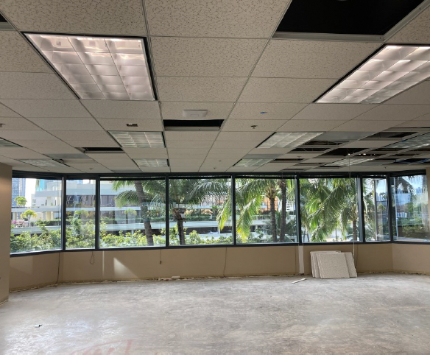
LumiSight Hoteling App KickOff
February 14, 2022

Slide 2
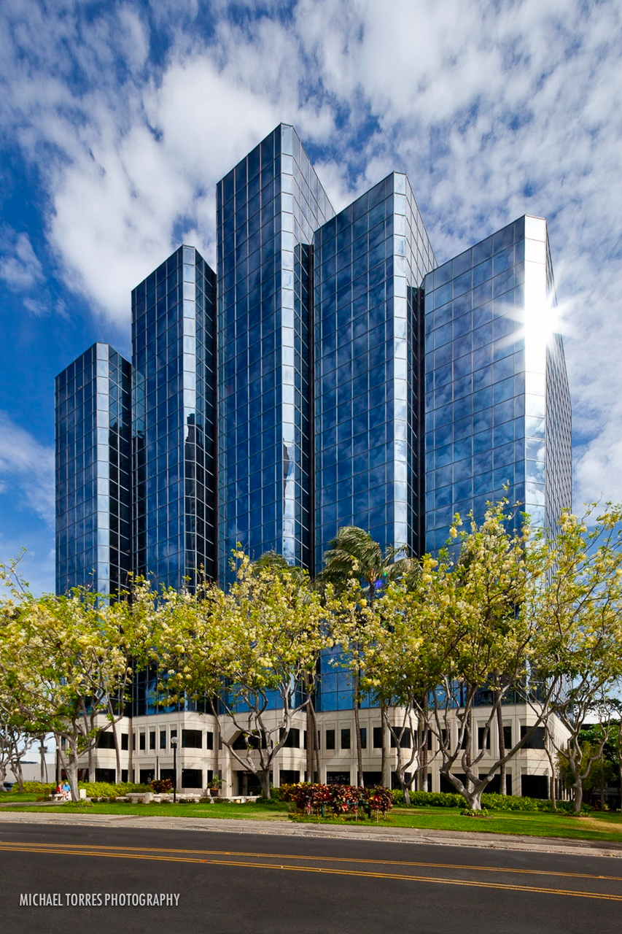
Today's Agenda
Welcome
Introductions
Project & Current Situation
Phase 1
Timeline
Getting Started

Slide 3
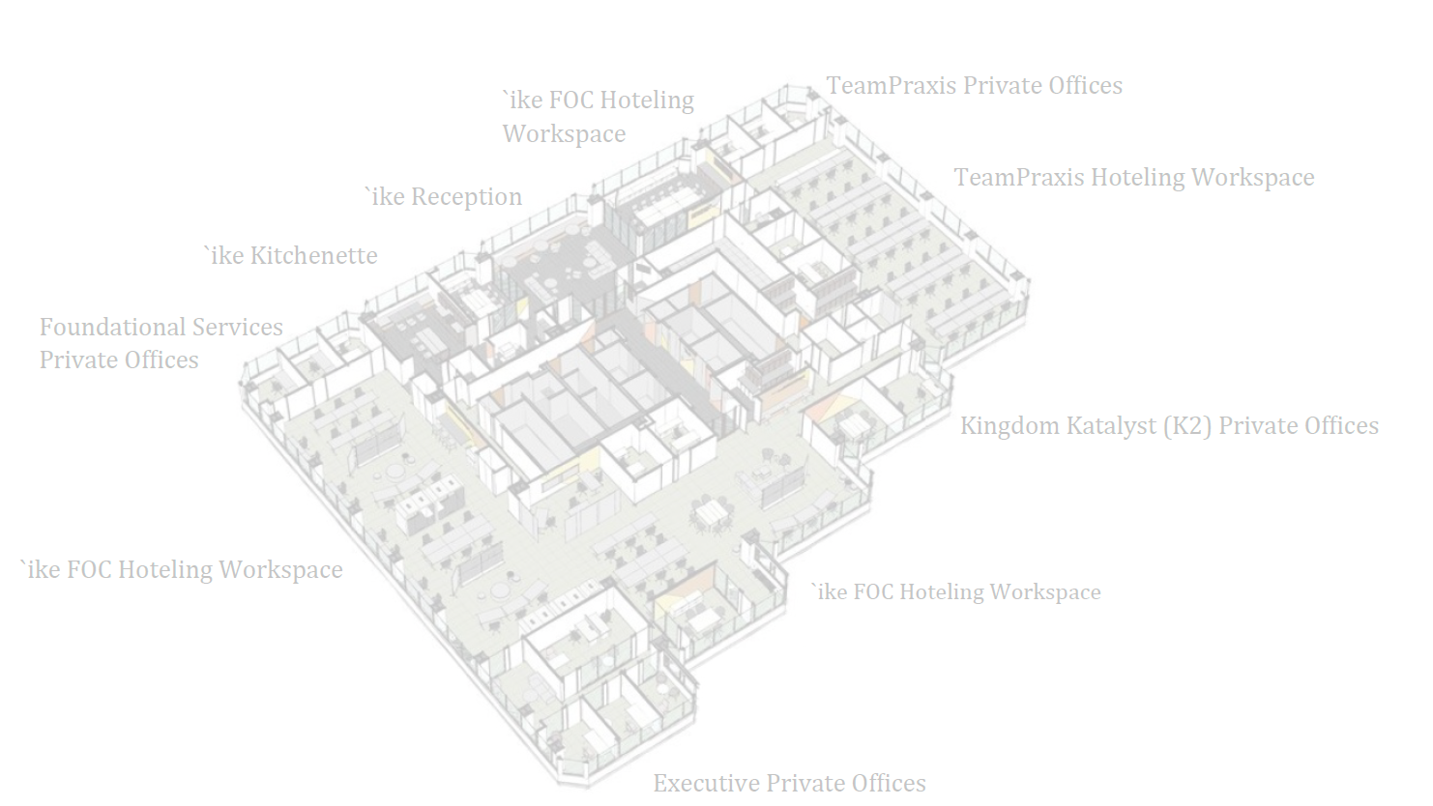
Introductions

Slide 4
About the Project
'Ike family of companies is condensing into one office space at beginning of April
'Ike, DataHouse, Team Praxis
Solutions on the market do not cater to the needs
Developing the future of the LumiSight Platform
Roughly 8 weeks to complete Phase 1

Slide 5
Project Team
Clyde Shiigi
Project Sponsor
Ky Pham
Product Owner
Alyssa Mencel
Project Manager
Jegnesh Gehlot
Mentor/Developer
Jordan Takemoto
Mentor/Developer
Riley Sodetani
Mentor/ Developer
Alvin Edrada
Back End Intern
Taylor Gabatino
Front End Intern
Timothy Huo
Back End Intern

Slide 6
Phase 1
Account Management
Transfer current user pool and login component from LumiSight
Office Space
Reservation Management
Employees can make a reservation for a desk or room
View their reservations
Cancel their reservations
Export reservation to Outlook
Admin receives notification of reservation
Admin can cancel reservation
View a Map of Workspaces
Upload a Map of Workspaces
Manage Desks/ Rooms (CRUD)
Admin Dashboard
View upcoming reservations
Filter reservations

Slide 7
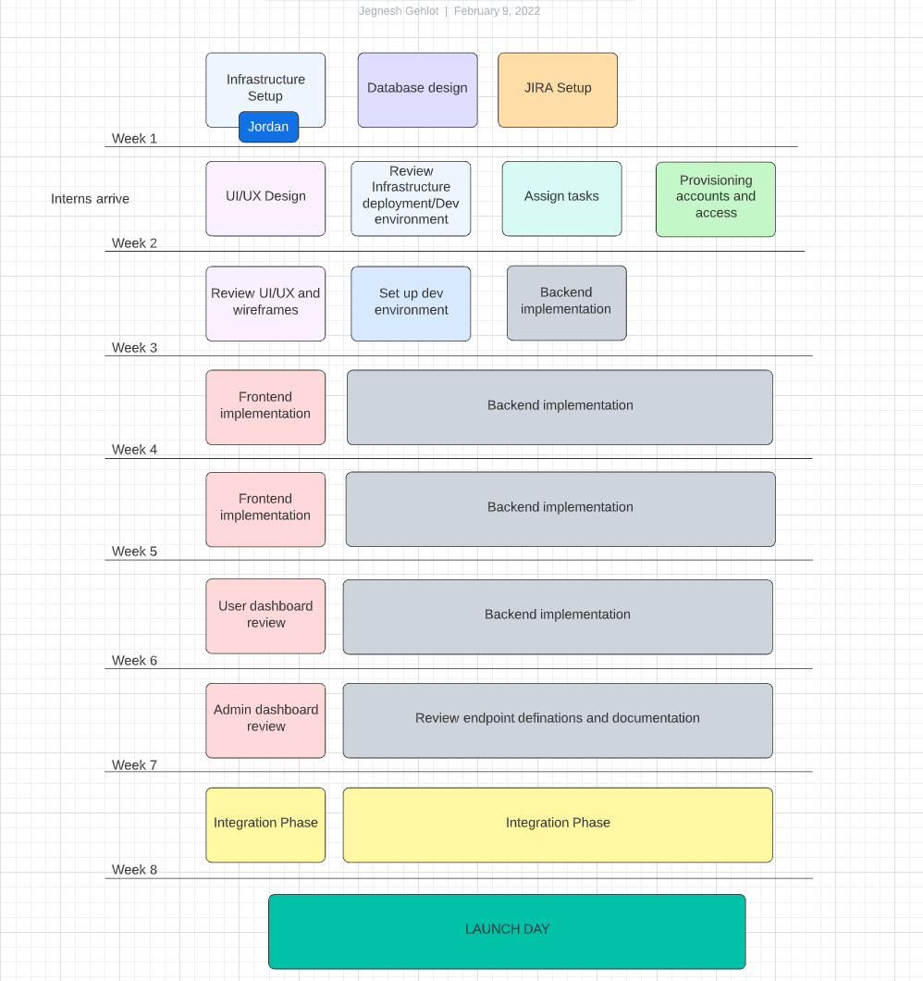

Slide 8
Getting Started

