Slide 1
Building better governments to service citizens with the cloud
Morgan Reed
Executive Government Advisor
Amazon Web Services

Slide 2
Agenda
Trends and challenges in government digital transformation
Overview of AWS in Public Sector
How AWS helps Government’s digital transformation

Slide 3
Technology is critical to improve citizen services, with cloud as the backbone
Citizens are raising their expectation of government interaction with responsive, digitally connected services
Many governments have now seen the importance of ensuring that citizen services are available online, and have worked to improve their e-government efforts
Cloud technologies, in particular, are considered “important” or “extremely important” to facilitate most key initiatives that governments are undertaking
Source: Build a better Government in the cloud – Forrester, 2018

Slide 4
However…
70% of government officials believe they lag behind private sector organizations.
— Deloitte, Digital Government Transformation: The journey to government’s digital transformation

Slide 5



Why governments get “stuck” in their digital transformation journey
Regulatory, privacy and security compliance
Legacy systems
Digital skills gap
¹https://aws.amazon.com/blogs/publicsector/addressing-public-sectors-digital-skills-gap-new-idc-report-reveals-biggest-challenges-opportunities/

Slide 6


How cloud helps to accelerate government digital transformation
Paves the way for innovation
Makes the world a better place
It offers:
      Disruptive innovation
      Speed and agility
      Virtually unlimited scalability
      Collaboration across teams
      Cost savings
It enables:
      World-changing projects
      Economic development
      Citizen services and engagement
      Research and education
      Environment sustainability

Slide 7

What is AWS?
AWS provides a highly reliable, scalable, low-cost infrastructure platform in the cloud that powers millions of businesses in over 190 countries around the world.
Experience
Building and managing cloud since 2006
Service breadth & depth
200+ services to support any cloud workload
Global footprint
26 Regions, 84 Availability Zones, 310+ Edge Locations
Pricing philosophy
109 proactive price reductions as of April 20, 2021
Community
Over 100,000 partners; 8,000+ Marketplace products

Slide 8



AWS in the public sector
7,500+
14,000+
35,000+
Government agencies
Educational institutions
Nonprofit organizations

Slide 9







































































Government, education, and nonprofit organizations are using AWS for digital transformation

Slide 10




















AWS is architected for government security requirements
MTCS
AWS CloudTrail & AWS Config
Call logging and configuration management for governance and compliance

Slide 11



Security is a shared responsibility
Customers concentrate on systems and applications, while AWS manages infrastructure
Facilities
Physical security
Compute infrastructure
Storage infrastructure
Network infrastructure
Virtualisation layer
Hardened service endpoints
Rich IAM capabilities
Network configuration
Security groups
OS firewalls
Operating systems
Application security
Proper service configuration
AuthN and account management
Authorisation policies
More secure and compliant systems than a single entity could normally achieve on its own
+
=

Slide 12

The cloud isn’t an “all-or-nothing” choice
…it’s a journey for the government.
Integrating AWS with on-premises infrastructure
Legacy data centers
AWS Cloud
Your on-premises apps
Active Directory
Network configuration
Encryption
Backup appliances
Your cloud apps
Users and access rules
Your private network
Encryption
Backups
AWS Direct Connect/VPN

Slide 13


Organizations are moving legacy applications and data to the cloud
GOALS
Accelerate business transformation
Windows
SAP
VMware
Databases
Mainframe
Increase agility and innovate quickly
Reduce operating costs
Legacy
Modern
Access cloud scale, performance, and operations
Improve security and compliance
>50%
of enterprise workloads and data are expected to be in a public cloud within 12 months
SOURCE: Flexera 2021 State of the Cloud Report

Slide 14

AWS has the tools, programs, and services
Windows
SAP
VMware
Databases
Mainframe
Legacy
Modern
Purpose-built AWS and partner offerings
Incentive
programs
Third-party offerings
Free resources
AWS Professional Services
Certified partner services

Slide 15
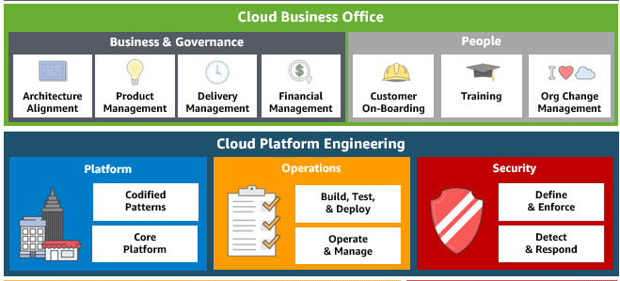
Establish Digital Transformation Office (DTO)
DTO IS A CROSS FUNCTIONAL, OUTCOME-DRIVEN TEAM THAT HAS THE FOLLOWING CAPABILITIES
Cloud Business Office
Provides Business & Governance and People support as the government embraces the move to cloud.
Cloud Platform Engineering
Configures and codifies the AWS platform to align with government standards for architecture, operations, security, and finance. Packages and continuously improves these standards as self-service deployable products and consumable service.

Slide 16
Build your team’s cloud skills
Digital Training
Over 500 free, on-demand courses that help your team learn new cloud skills and services when and where it’s convenient
Classroom Training
In-person and virtual training* from instructors who teach your team in a hands-on learning environment
AWS Certification
Identify skilled professionals to implement cloud initiatives using AWS
Education Programs
Connect with candidates prepared to pursue entry-level cloud roles
Learn more at aws.com/training

Slide 19

Feedback Please!
URL : https://eventbox.dev/survey/VLZM1X1
Morgan Reed | Executive Government Advisor, SLG | AWS
Email : mmreed@amazon.com
Casey Burns | Director SLG Verticals and Strategy | AWS
Email : cjburns@amazon.com

