Slide 1
Arizona’s Journey to the Cloud
Morgan Reed
Executive Government Advisor
Amazon Web Services
Notes:
Good morning Governor Ige and distinguished guests
My name is Morgan Reed and I work as an Executive Government Advisor for Amazon Web Services. I’m part of a team of former government executives who have led transformation in the public sector. My role is to help coach government leaders and decision makers through their cloud adoption journey, think through strategy, remove barriers, and achieve their business goals.
Prior to coming to AWS, I had the priveledge of working as the Chief Information Officer for the State of Arizona, and this is the story of what we were able to accomplish in less than 4 years.
Lets start by talking about mother nature. Here on the beautiful Hawaiian islands there could be hurricanes or volcanoes. In Arizona we don’t have either of those, but in the hot summer months we do have dust storms. (1min)

Slide 2
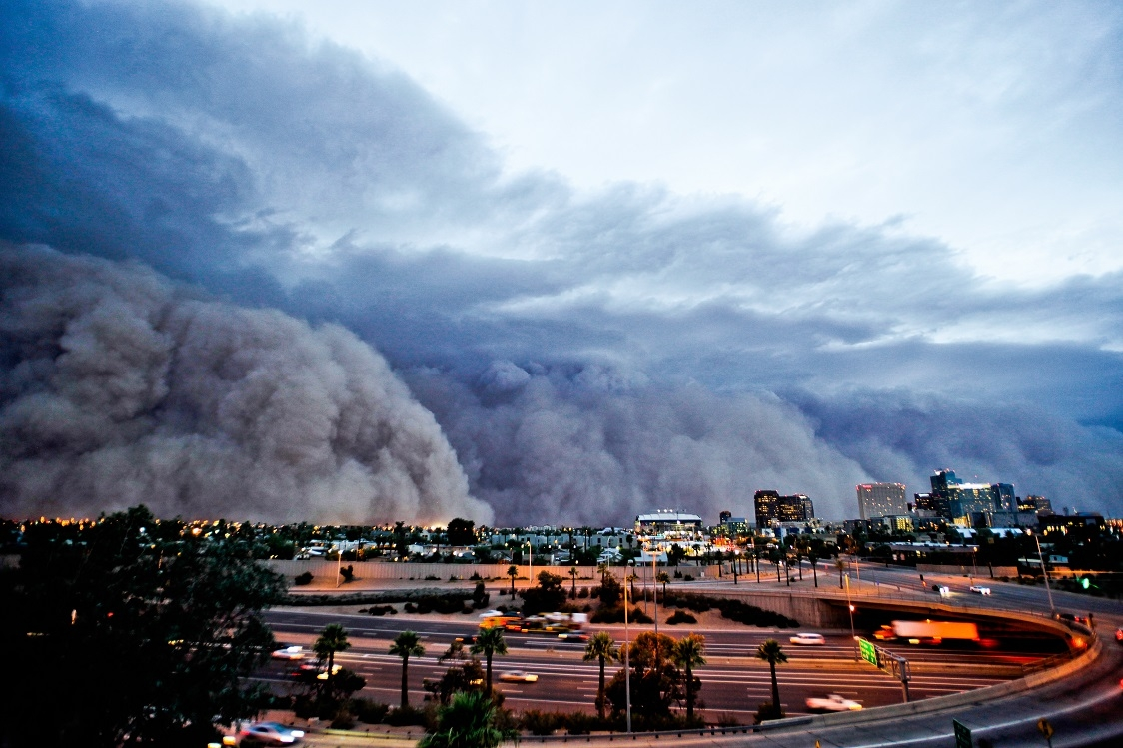
How it started…
Notes:
Why cloud?
In July, 2011, the state experienced a dust storm 100miles wide, over 1mile high, traveling at 40-50mph, lasted 2 hours
The result, was a 3-day outage to the state's datacenter
7 Agencies had line of business systems on our mainframe were down, some with citizens lining up outside to get service.
The datacenter - aging facility, 40yr old building
$15M in deferred maintenance and spend $30M to bring it up to current DC standards
When we were competing with the same general fund that paid for teachers, doctors and police, we weren't going to get what we needed.
That's what I walked into on my first day as CIO in late 2015. (2min)

Slide 3
What we did
ESTABLISH A MODERN FOUNDATION
1
2
3
4
Cloud-First Policy
Why Not Cloud?
Trained Our People
Core Network to Colo
Notes:
What we did first was
Established a modern foundation
Set a Cloud-First policy, but not cloud-only
At the time, Hardware refresh requests were auto-approval, now had to be justified
Had to ask every agency "Why can't this go in the cloud", and when they looked into that it turns out most of them could.
Trained our people to use new tools and technologies to better solve government problems
Migrated our core network to colo, to increase our cloud network connectivity (2min)

Slide 4
What we did
EMBRACED CLOUD TECHNOLOGY
5
6
7
8
Mainframe to IBM Cloud
Email to Google
Permits on Salesforce
Goal: Data Center Exit
Notes:
What we did
Next we embraced cloud technology
Moved mainframe to the cloud
Migrated 30 on-prem email systems to one cloud-based system with Google, largest gov customer.
We moved 15 of our agency licensing and permitting systems to SalesForce
Set a goal to exit the state’s largest datacenter in 18 months, 6mo planning, 12mo execution
Created a burning platform to drive action from my team, and our customers.

Slide 5
What we learned
Governance | communication | optimization | speed
25-50%
In the Cloud
75%
On AWS
GOAL
REALITY
Notes:
What we learned
Governance was important, our old models needed to be rethought and modernized
Communication was key, because when folks did push back, we talked through it
Optimizing our footprint and right-sizing our applications saved us $
What we hoped for? 25-50% in the cloud
What we got? 75% to AWS
Saved $4M annually

Slide 6
…How it’s going
1
2
3
4
Cloud native applications
Data lakes
Data-driven decisions
Recruiting top talent
Notes:
How it’s going now?
Agencies have embraced the cloud
Using cloud-native applications
Setting up data lakes to make data-driven decisions
Modern technology is attracting top talent from the private sector, believe in Gov’s mission
Now using over 50 AWS services:
Shut down another 87 or 90 server rooms
State now tracking $11M in savings
If Arizona can do it, so can Hawaii, and our team at AWS is here to help.

Slide 7
Notes:
Thank you!

Slide 8
Feedback Please!
URL : https://eventbox.dev/survey/VLZM1X1
Morgan Reed | Executive Government Advisor, SLG | AWS
Email : mmreed@amazon.com
Casey Burns | Director SLG Verticals and Strategy | AWS
Email : cjburns@amazon.com

