Slide 1
AWS Deep Racer for AI/ML Learning
Nick Sciarrilli
Clyde Shiigi
Solutions Architect
Amazon Web Services
Chief Innovation Officer
DataHouse

Slide 2
AWS Deep Racer Initiative

Slide 3
What is AWS DeepRacer?
An educational device, designed to put machine learning in the hands of developers in a fun and exciting way. Start your machine learning journey with AWS DeepRacer

Slide 4
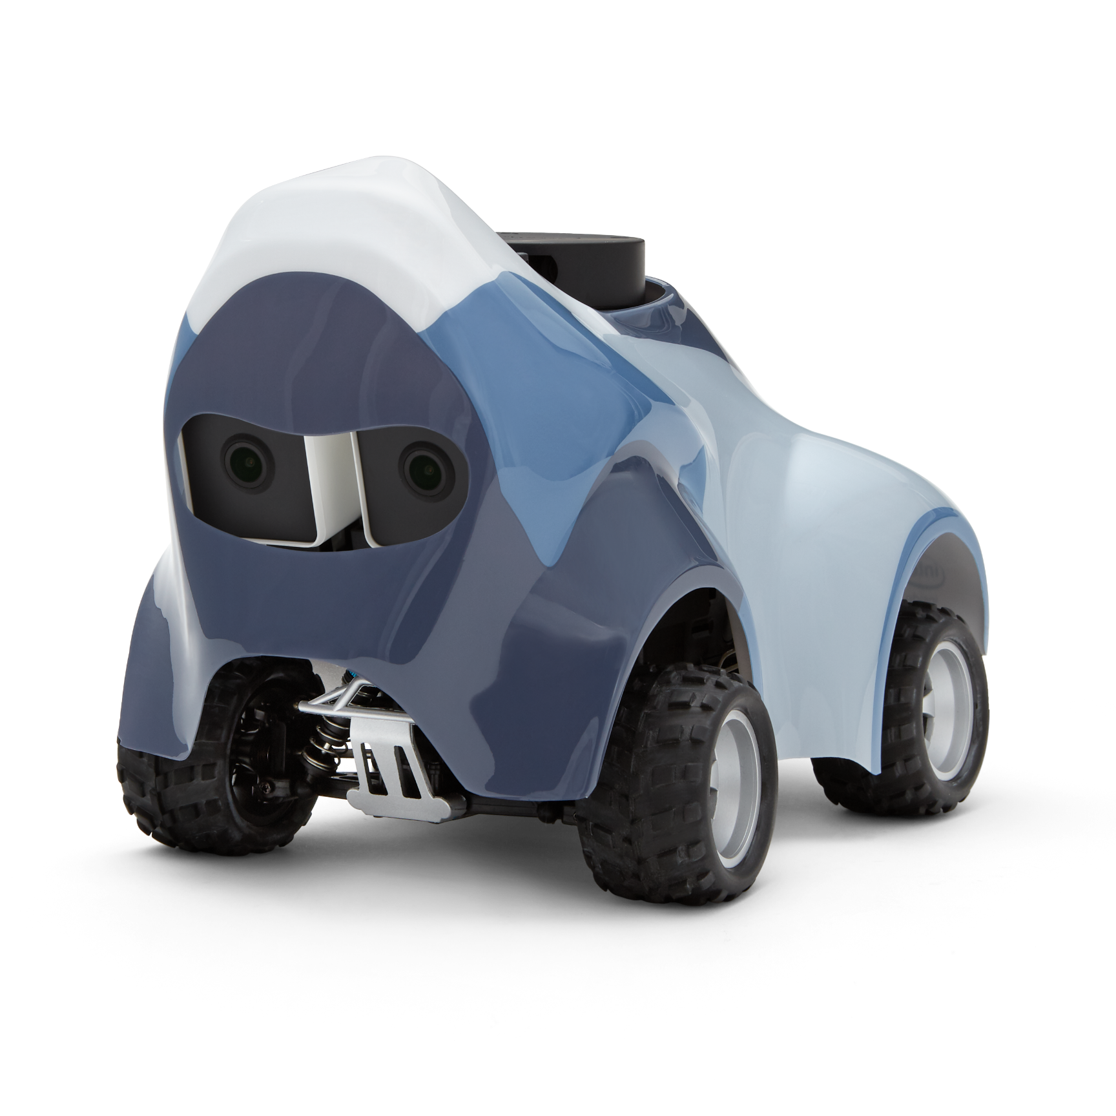


Under the hood
1:18 4WD scale car
Intel Atom processor
Intel distribution of OpenVINO toolkit
Stereo Camera (4MP)
360 Degree 12 Meters Scanning Radius LIDAR Sensor
System memory: 4 GB RAM
802.11ac Wi-Fi
Ubuntu 16.04.3 LTS
ROS Kinetic

Slide 5

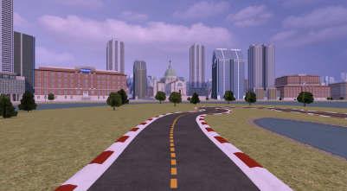
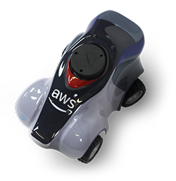
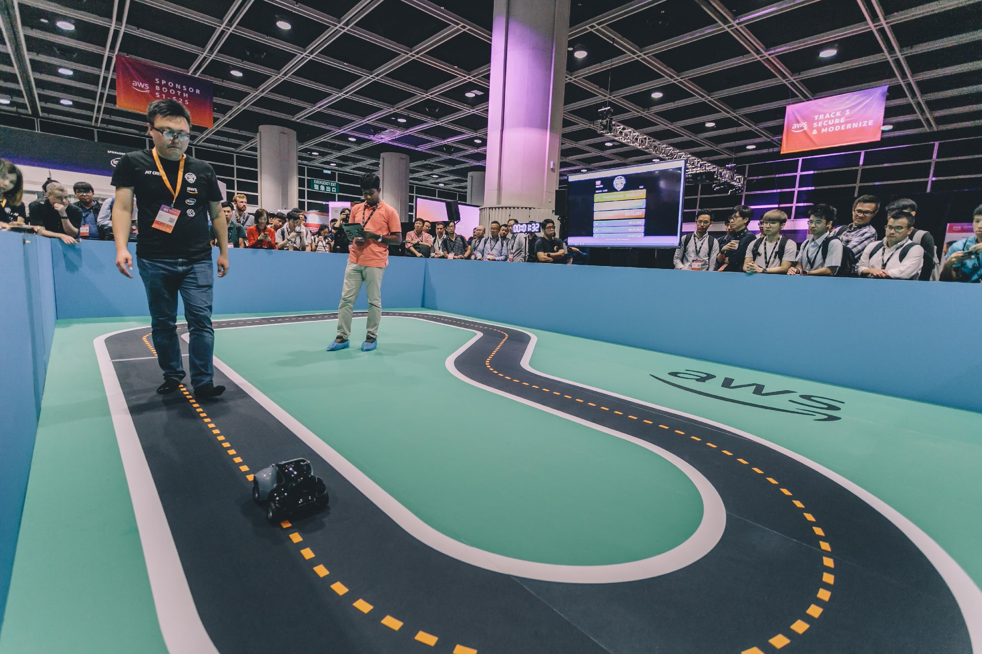
AWS DeepRacer: An exciting way for developers to get hands-on experience with reinforcement learning (RL)

Slide 6
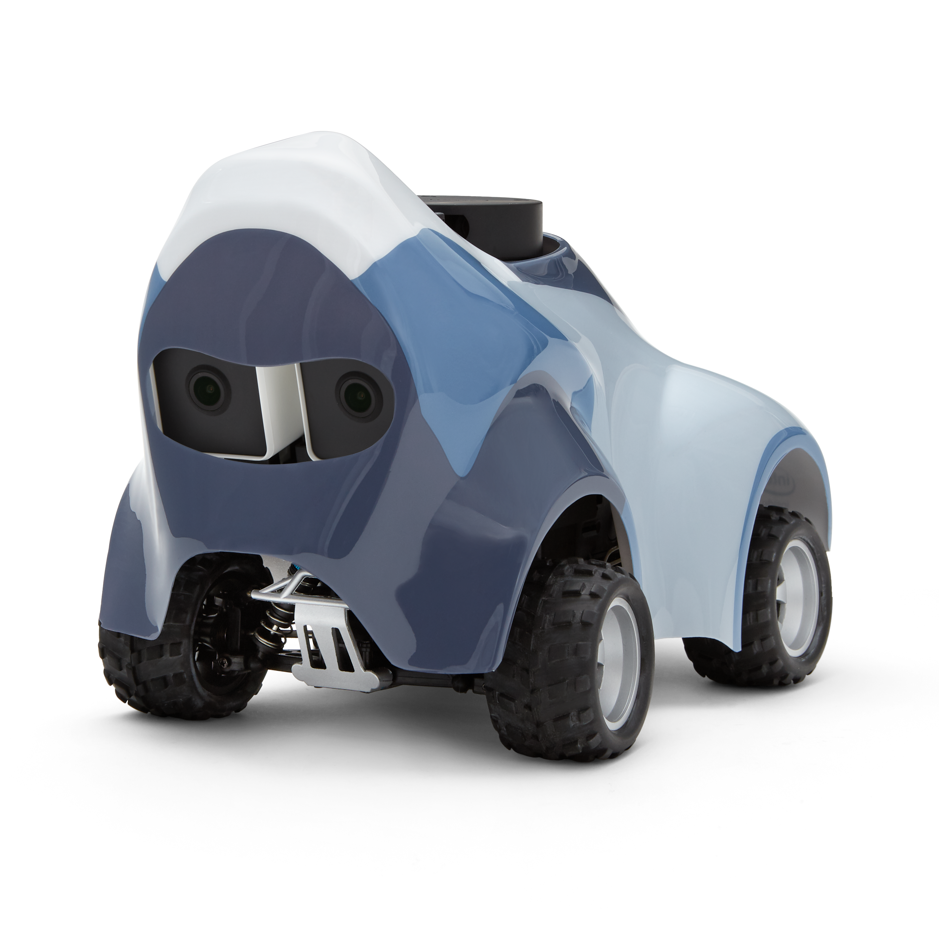
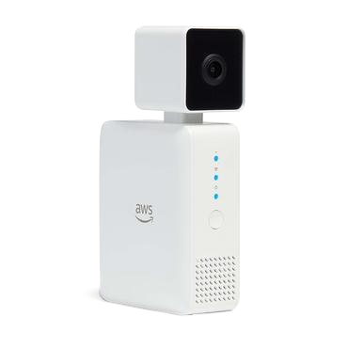

Additional ML Devices
AWS DeepLens
Get hands-on with computer vision using the world’s first deep learning-enabled video camera
AWS DeepComposer
Learn generative artificial intelligence (AI) by collaborating with AI to create music
AWS DeepRacer
Race in global leagues with a fully autonomous race car and learn reinforcement learning

Slide 7
The AWS AI/ML stack
Broadest and most complete set of machine learning capabilities
SPECIALIZED
Business processes
Amazon Personalize
Amazon Forecast
Amazon Fraud Detector
Amazon Lookout for Metrics
Search
Amazon Kendra
Code + DevOps
Amazon CodeGuru
Amazon DevOps Guru
Industrial
Amazon Monitron
Amazon Lookout for Equipment
Amazon Lookout for Vision
Healthcare
Amazon HealthLake
Amazon Comprehend Medical
Amazon Transcribe Medical
AI SERVICES
Core
Text & Documents
Amazon Translate
Amazon Comprehend
Amazon Textract
Chatbots
Amazon Lex
Speech
Amazon Polly
Amazon Transcribe
Amazon Transcribe Call Analytics
Vision
Amazon Rekognition
AWS Panorama
SAGEMAKER CANVAS
SAGEMAKER STUDIO LAB
Amazon sagemaker
ML SERVICES
Label
data
No-code ML
for business analysts
Learn
ML
Prepare data
Store
features
Detect bias
Build with notebooks
Train
models
Tune
parameters
Deploy in production
Explain
predictions
Manage
& monitor
Manage
edge devices
CI/CD
ML FRAMEWORKS
& INFRASTRUCTURE
PyTorch, Apache
MXNet, TensorFlow
Amazon EC2
CPUs
GPUs
AWS Inferentia
AWS Trainium
Habana
Gaudi
FPGA
Elastic
inference

Slide 8
Learn ML with AWS Training and certification
The same training that our own developers use, now available on demand
Role-based ML learning paths for developers, data scientists, data platform engineers, and business decision makers
70+ free digital ML courses from AWS experts let you learn from real-world challenges tackled at AWS
Validate expertise with the
AWS Certified Machine Learning - Specialty exam
Visit https://ml.aws

Slide 9
DataHouse Deep Racer Initiative

Slide 10
About DataHouse
Founded in 1975​
Largest and longest-standing Systems Integrator (SI) in Hawaii​
Headquartered in Honolulu, with staff in Hawaii, California, Washington, American Samoa, Vietnam
Over 400+ employees in all subsidiaries​

Slide 11

Start with Why
Invest in strategic technologies
Empower our workforce
Reinforce our culture

Slide 12
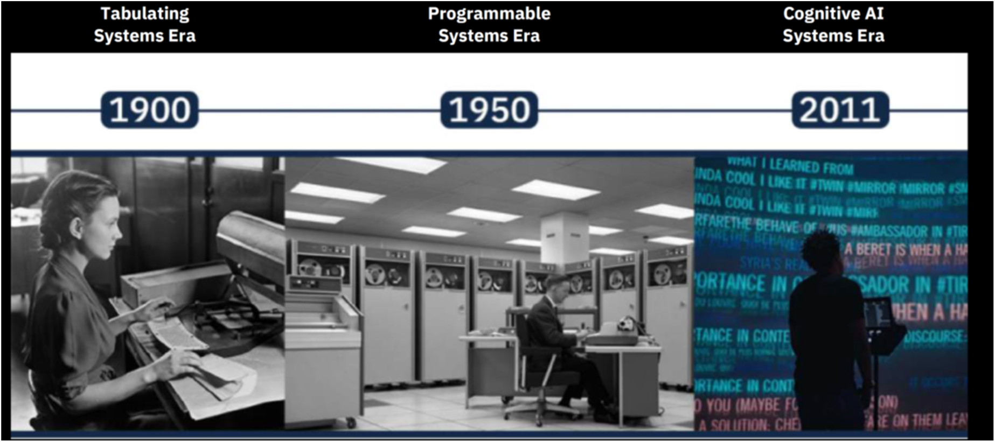
Invest in strategic technologies

Slide 13
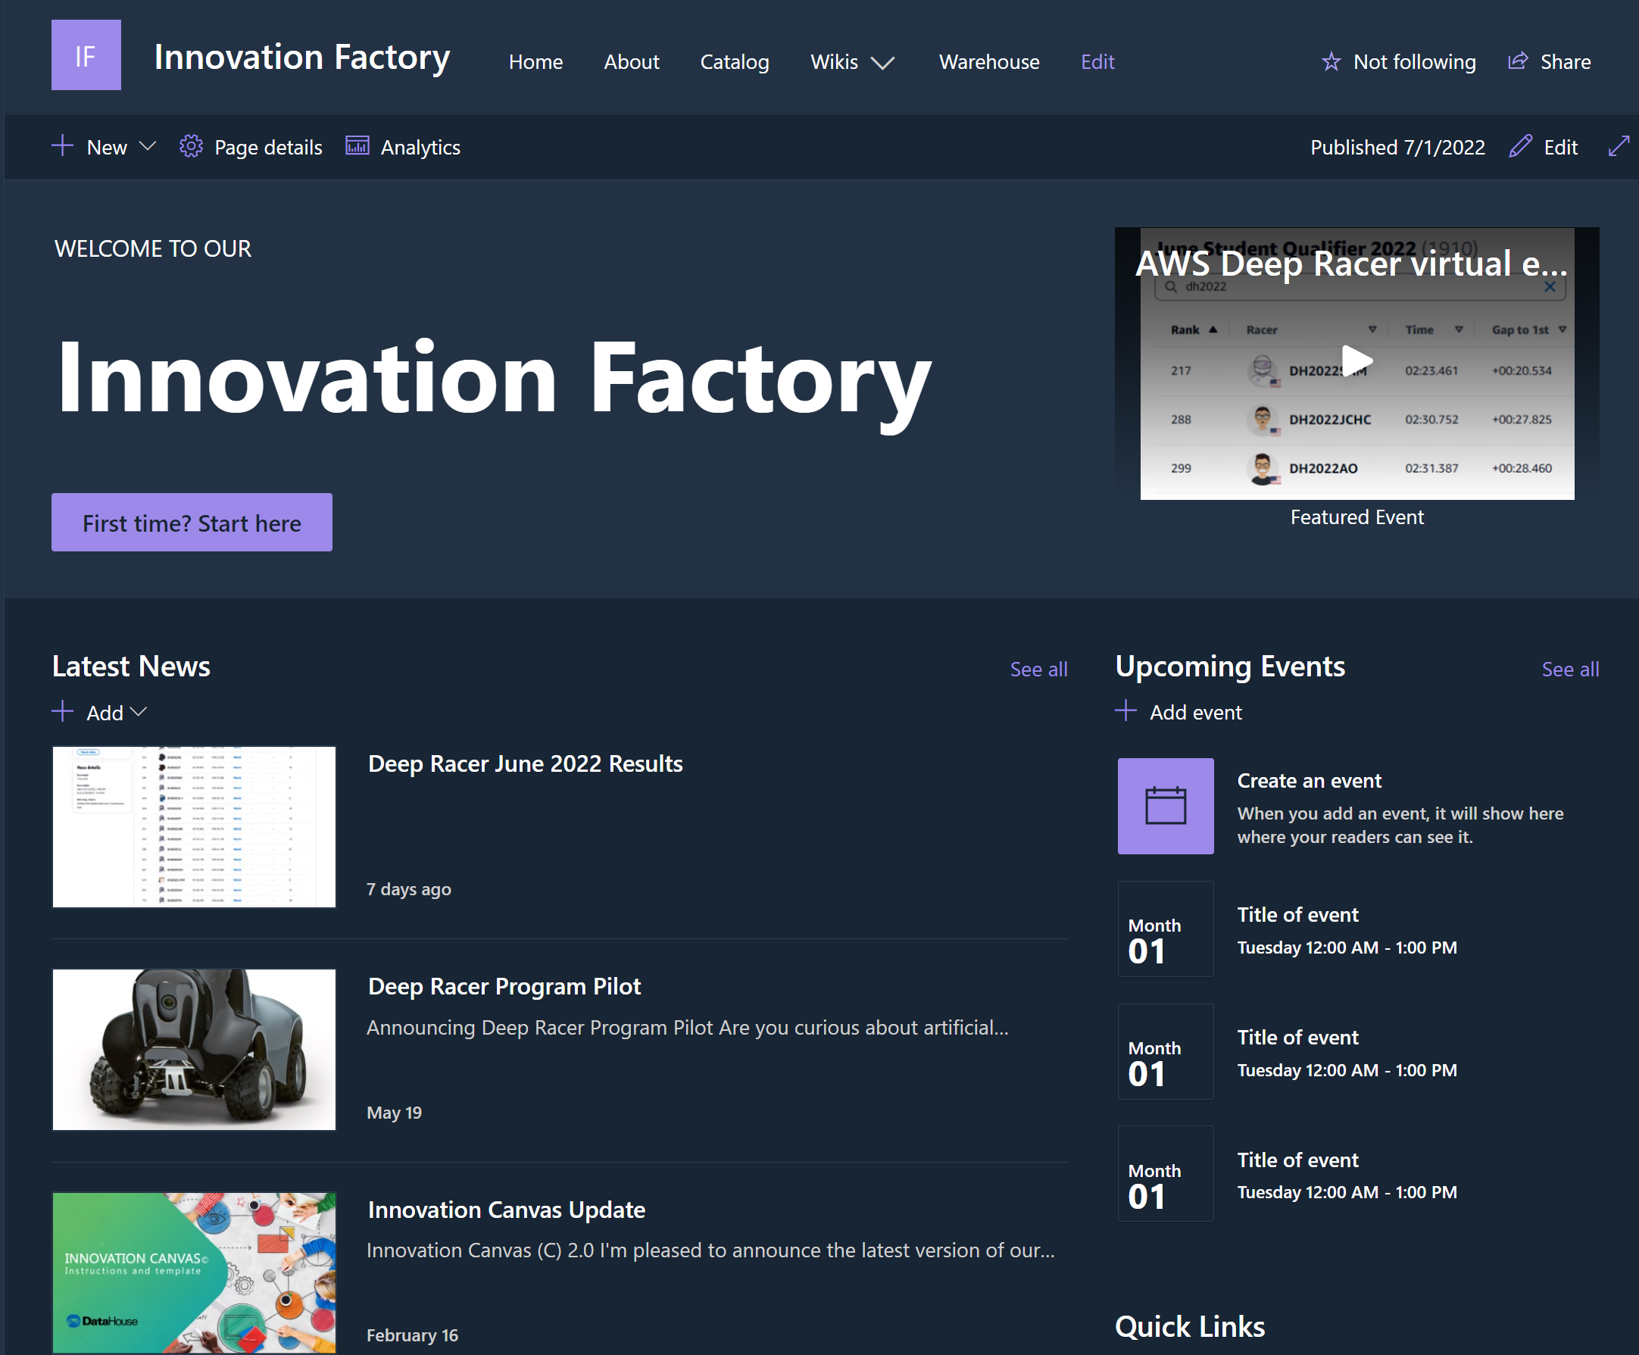
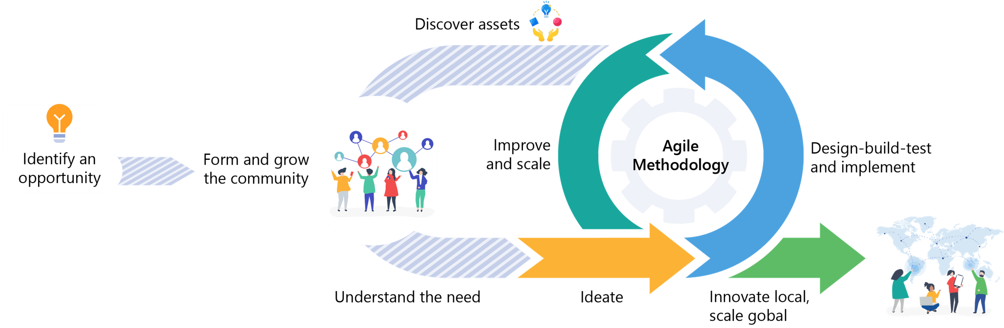
Empower our workforce
    Learn new skills
    Share knowledge
    Make connections
    Form and grow communities

Slide 14
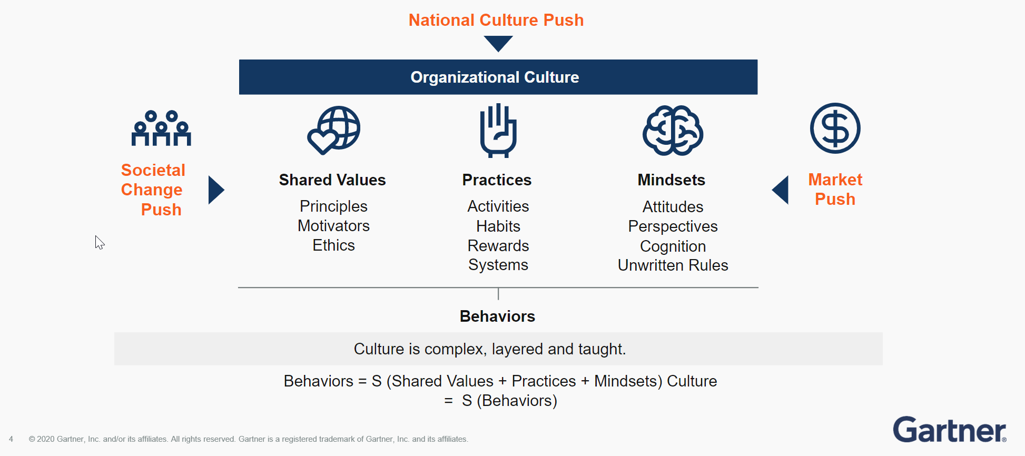
Reinforce our culture
    Passionately innovative
    Value relationships and people
    Continually learn and grow

Slide 15
Deep Racer Program
Summary
Goals
Provide an easy onramp to learn about AI/ML through a fun, agile approach to learning
Follow our Community Sourced Innovation (CSI) model by involving and connecting staff, interns, and family members
Partner with AWS to promote innovation in our community
Guided AI/ML learning experience using autonomous car use case and online resources
Augment online training with mentor led sessions.
Three-week duration
Included DH staff, interns, and family members
Participants compete for fastest lap time and prizes
Awarded prize for the top finishers

Slide 16
Planning Committee Members
Program sponsor
Promoters
  Spokespersons to promote event
Mentors
  Present at group sessions
  Walk through process of training car
  Provide tips and how to
  Answer questions
  Respond to Slack questions
People coordination/communications
  Send announcements
  Schedule events
  Arrange prizes
Historian
  Capture moments
AWS
  Provide support in group session
  Present other AI use case/solutions

Slide 17
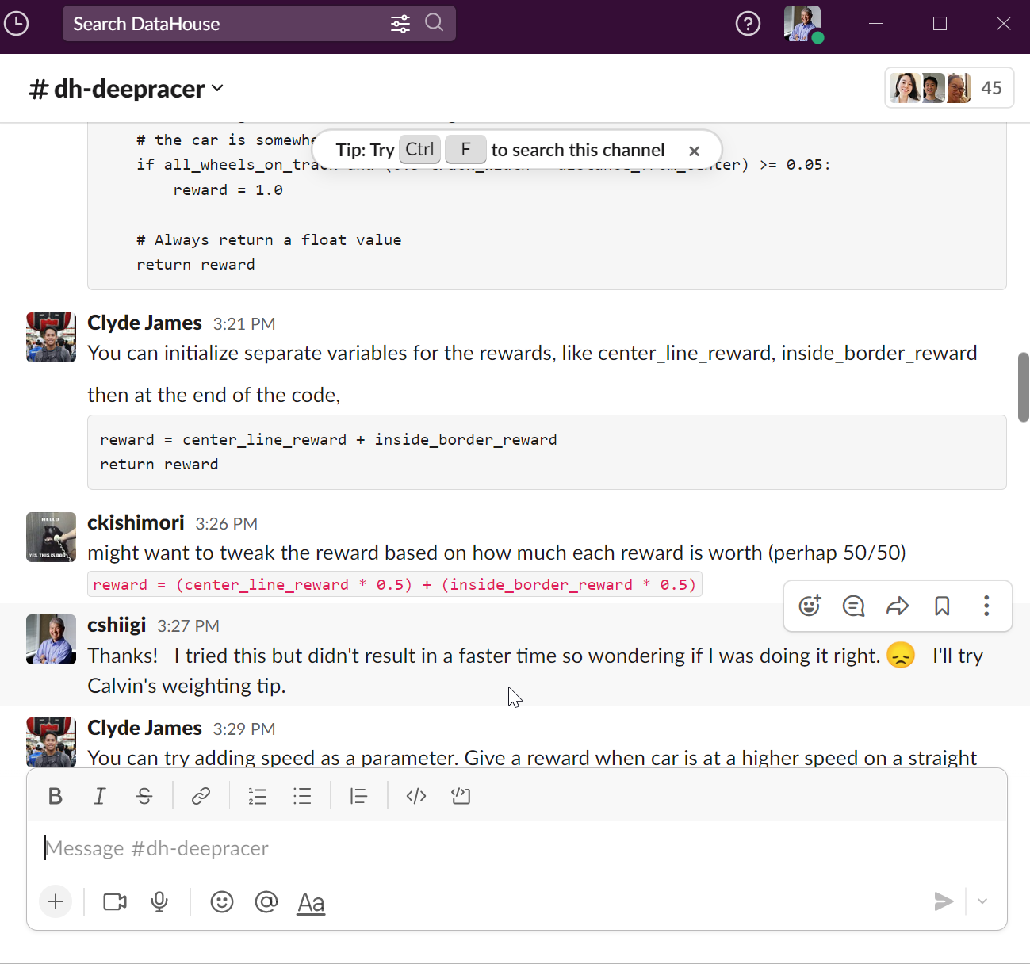
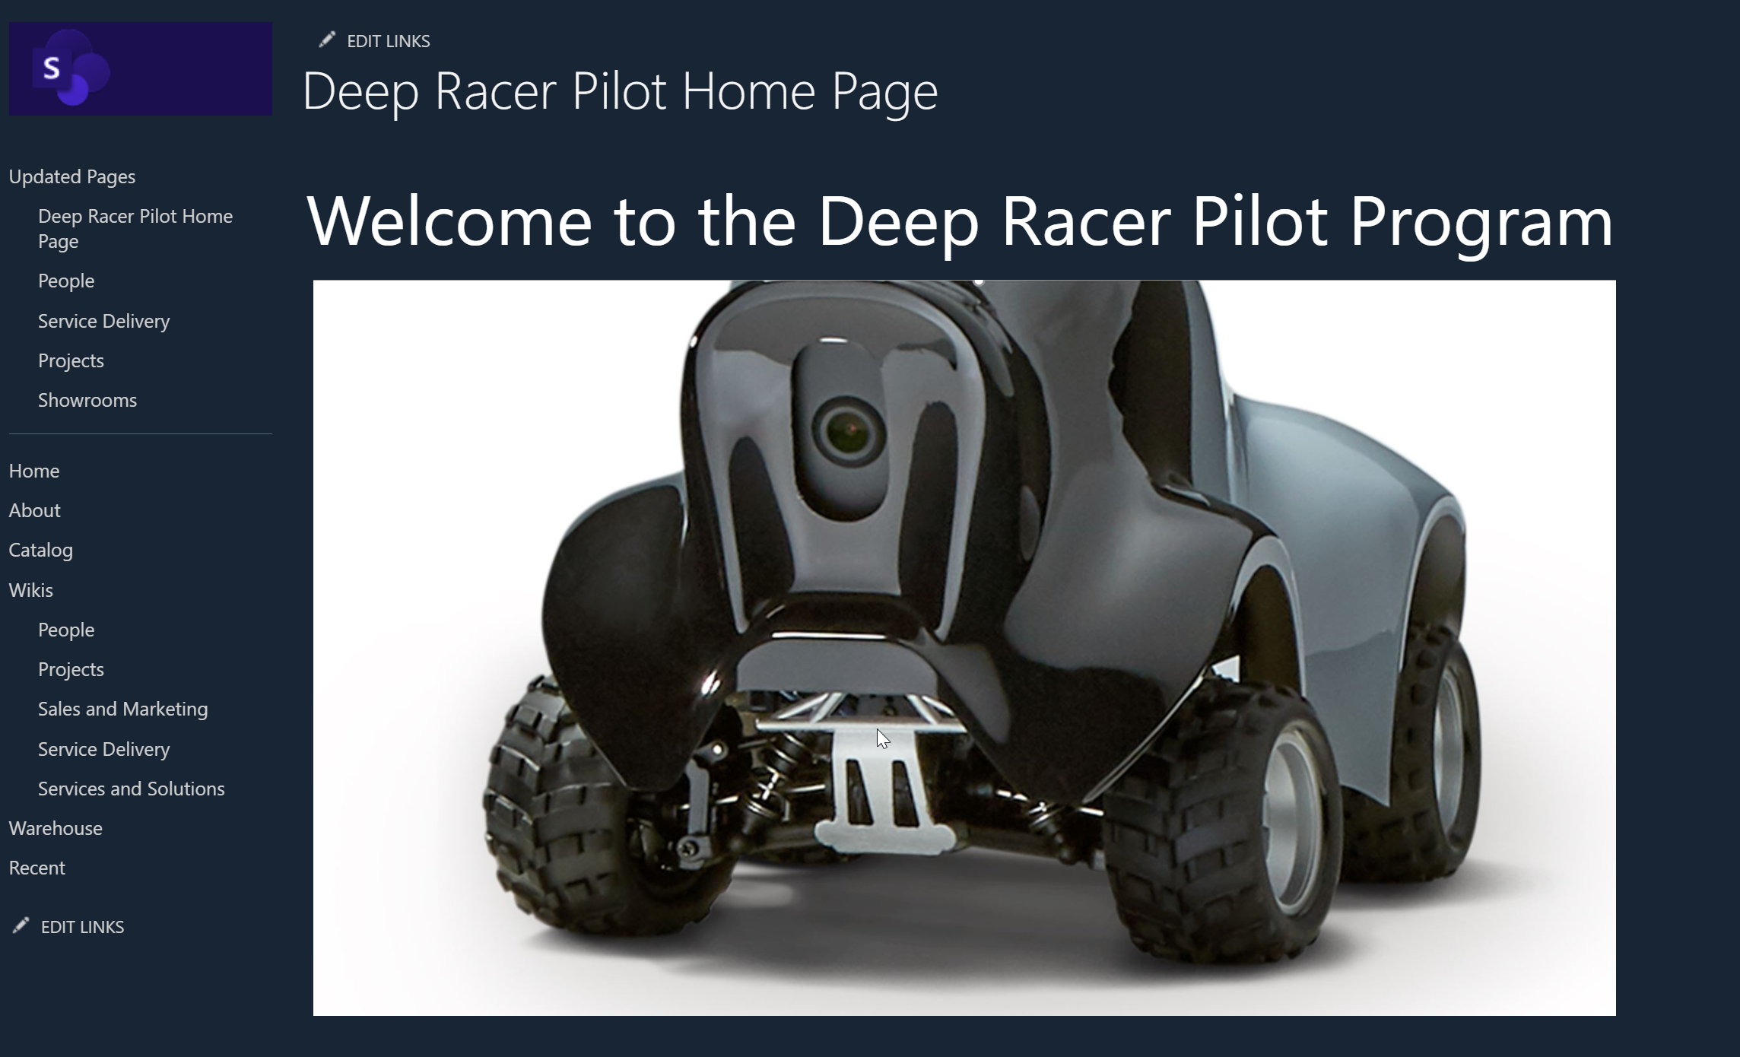
Deep Racer Program Resources
Wiki Site
Slack Channel

Slide 18
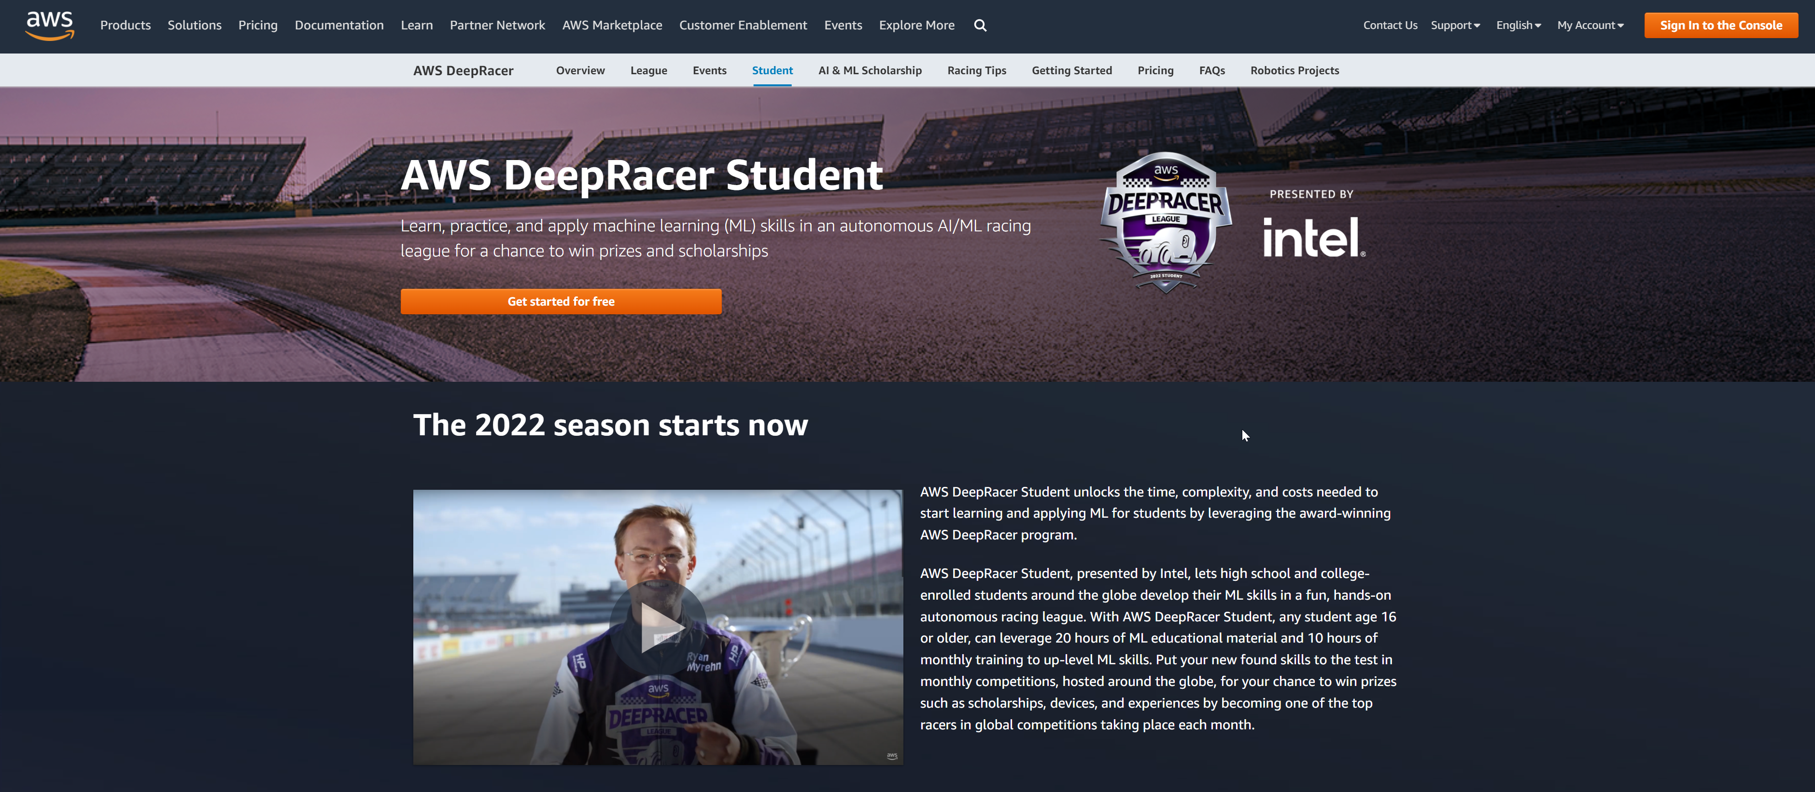
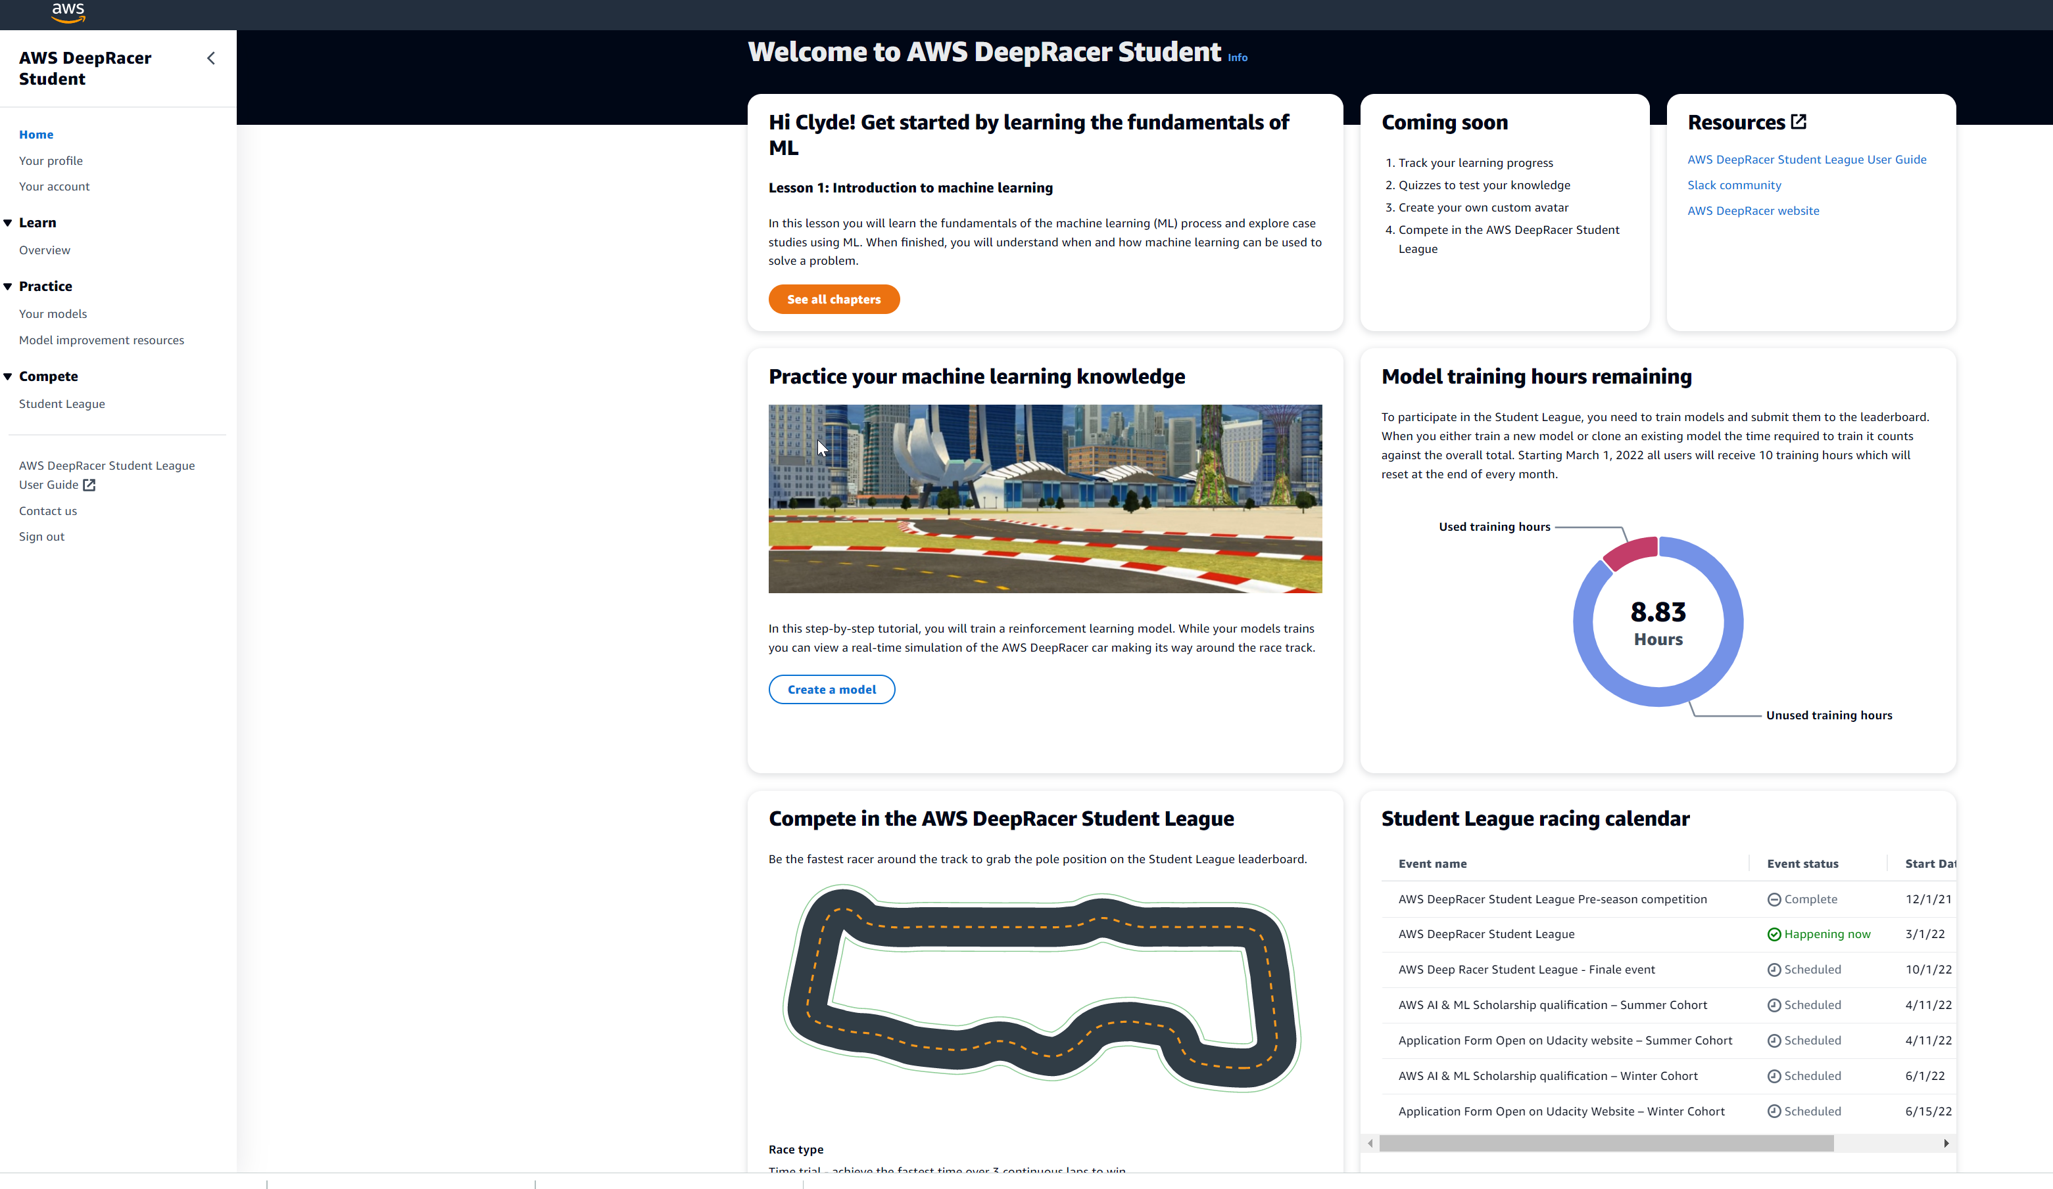
Step 1 - Enroll
Visit Innovation Factory – Deep Racer Pilot Program Wiki for overview, synopsis of program and FAQs
Sign up for a Deep Racer Student account at https://aws.amazon.com/deepracer/student/
  Racer name – “xxxxxx" followed by your initials
Subscribe to Slack Channel #dh-deepracer

Slide 19
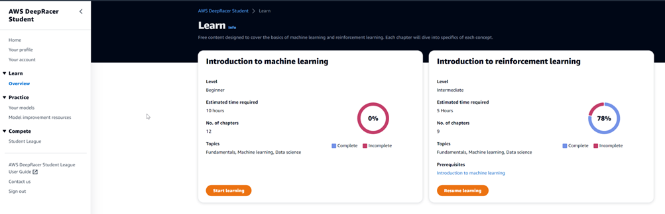
Step 2 - Learn
Complete 7 chapters in week 1
(estimated total completion time 1-2 hrs.)

Slide 20
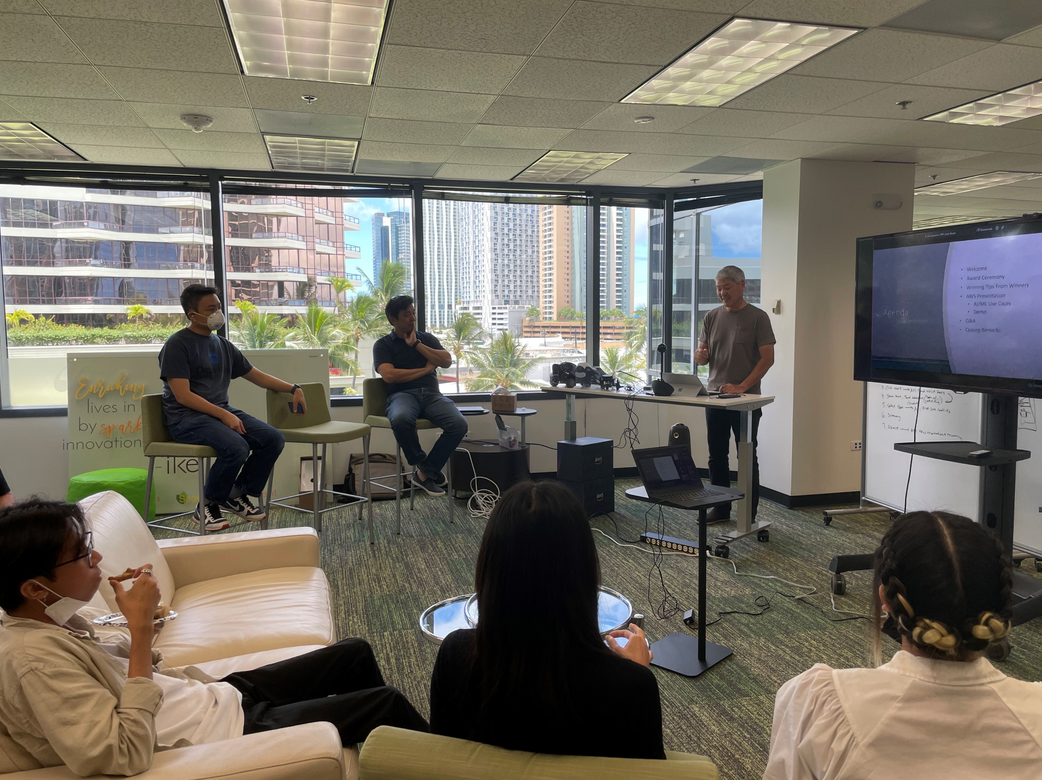
Step 3 – Collaborate
At the end of week 1, a group session was held with mentors and participants
Questions on courses
Walkthrough steps to create and train your Deep Racer model
AWS Deep Racer expert tips

Slide 21
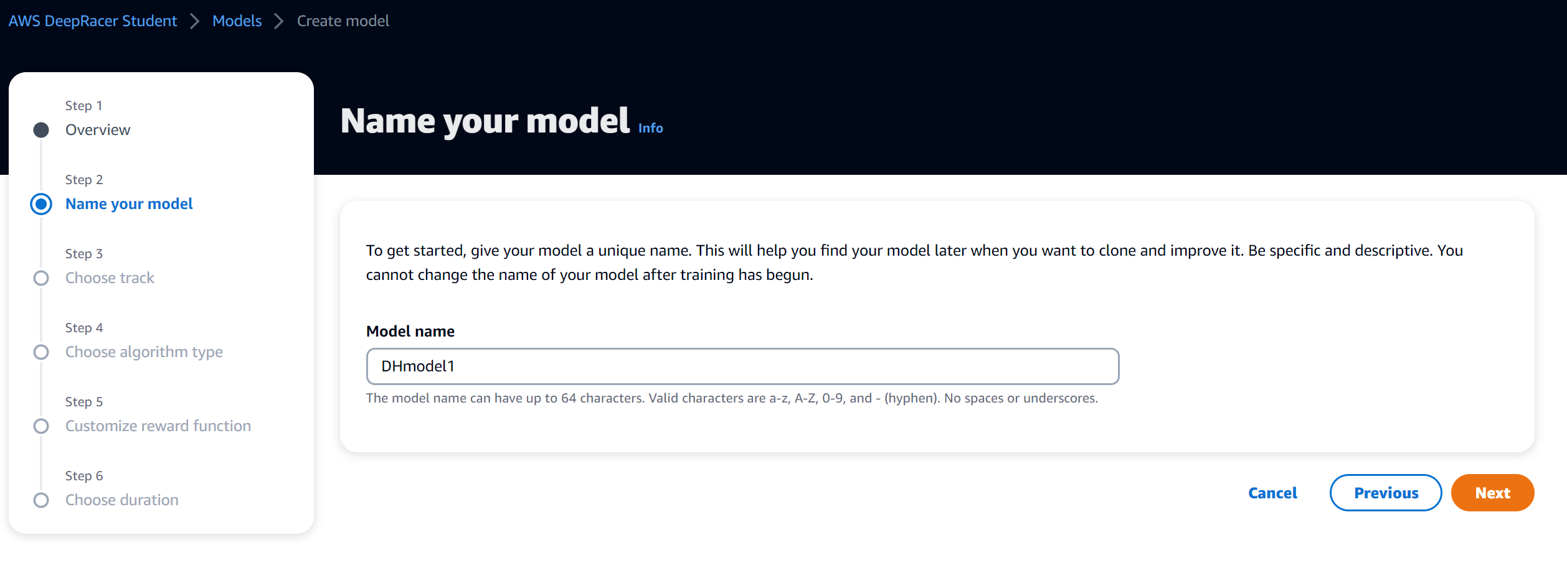
Step 4 – Build
Name your model

Slide 22
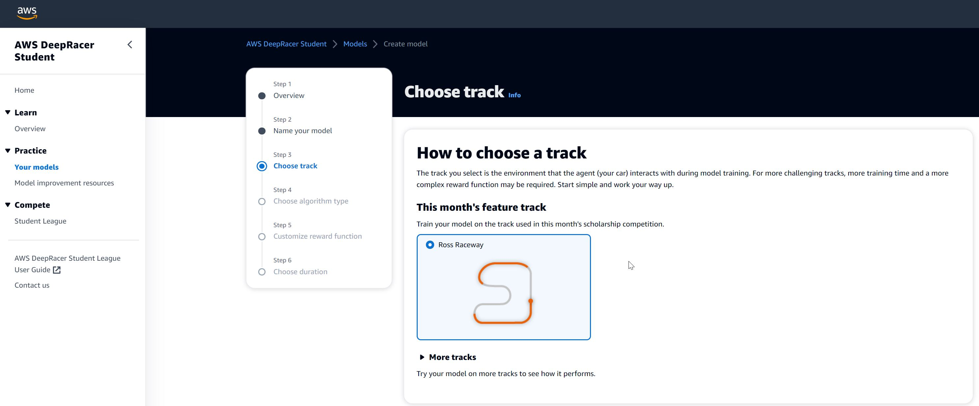
Step 4 – Build
Choose track - Select Ross Raceway

Slide 23
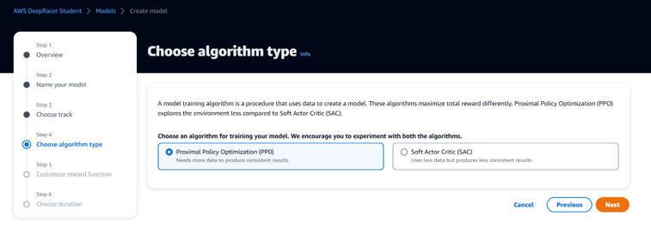
Step 4 – Build
Select Algorithm Type - PPO

Slide 24
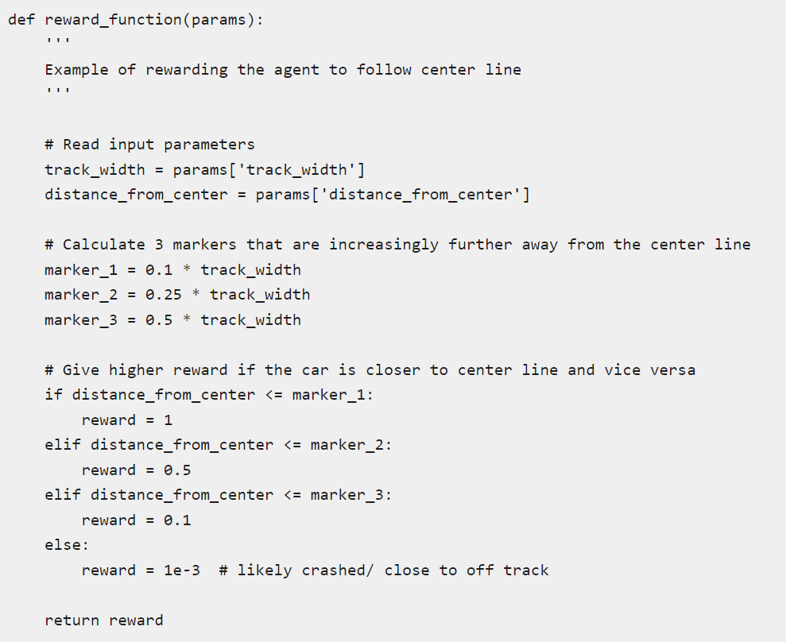
Step 5 – Train
During week 2 and 3, everyone creates and trains their car and enhances the reward functions to improve performance and lower elapsed times.
Everyone is allocated 10 hours of training time.
You may work independently or form teams to share ideas and models.

Slide 25
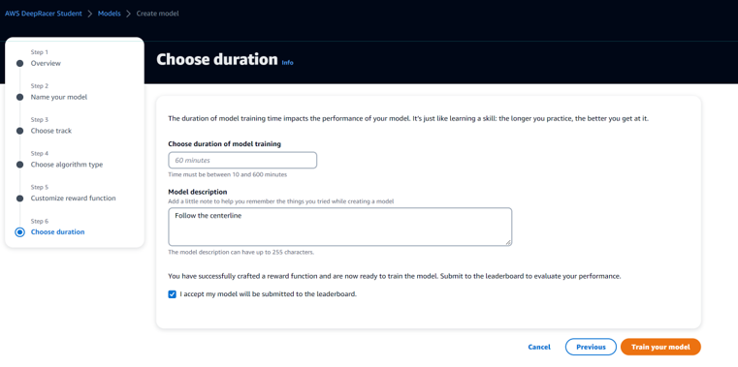
Step 5 – Train
Choose duration
Select how many minutes to train your model e.g. 15-60 min – everyone has a maximum of 10 hrs total training times

Slide 26
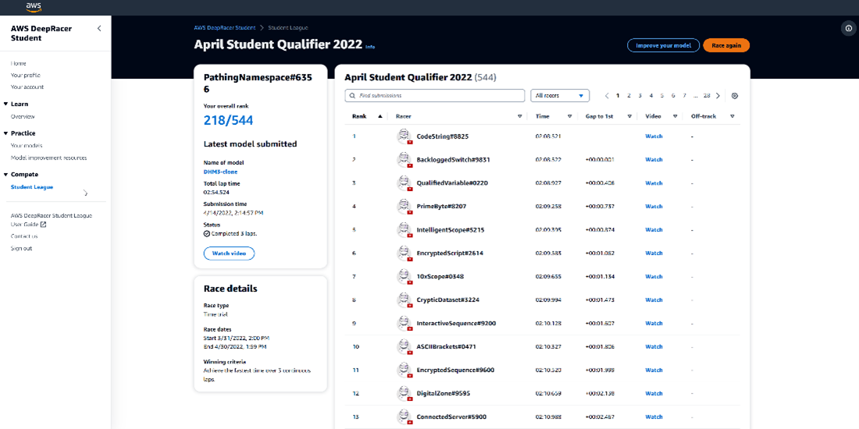
Step 6 – Race
After you are satisfied with your car, enter it in the Deep Racer Student League to get a ranking and an elapsed time.

Slide 27
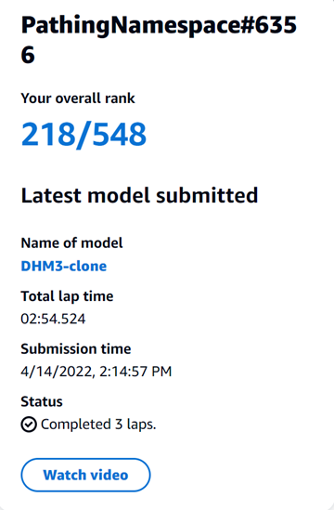
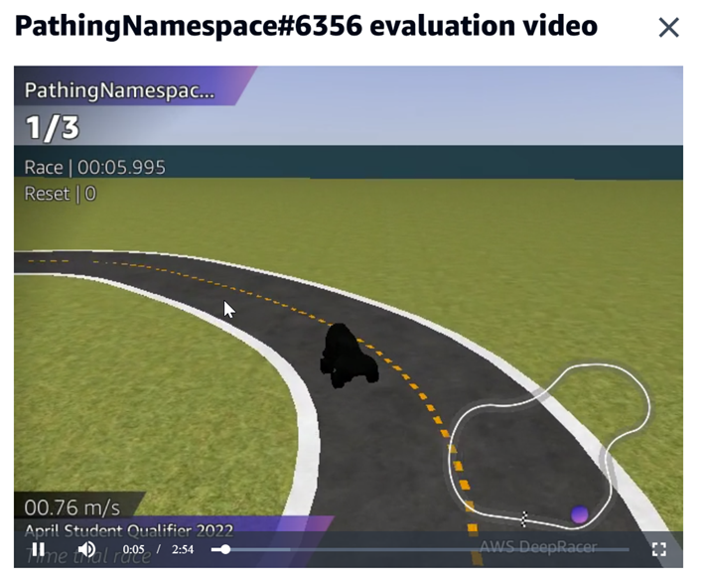
Step 6 – Race

Slide 28
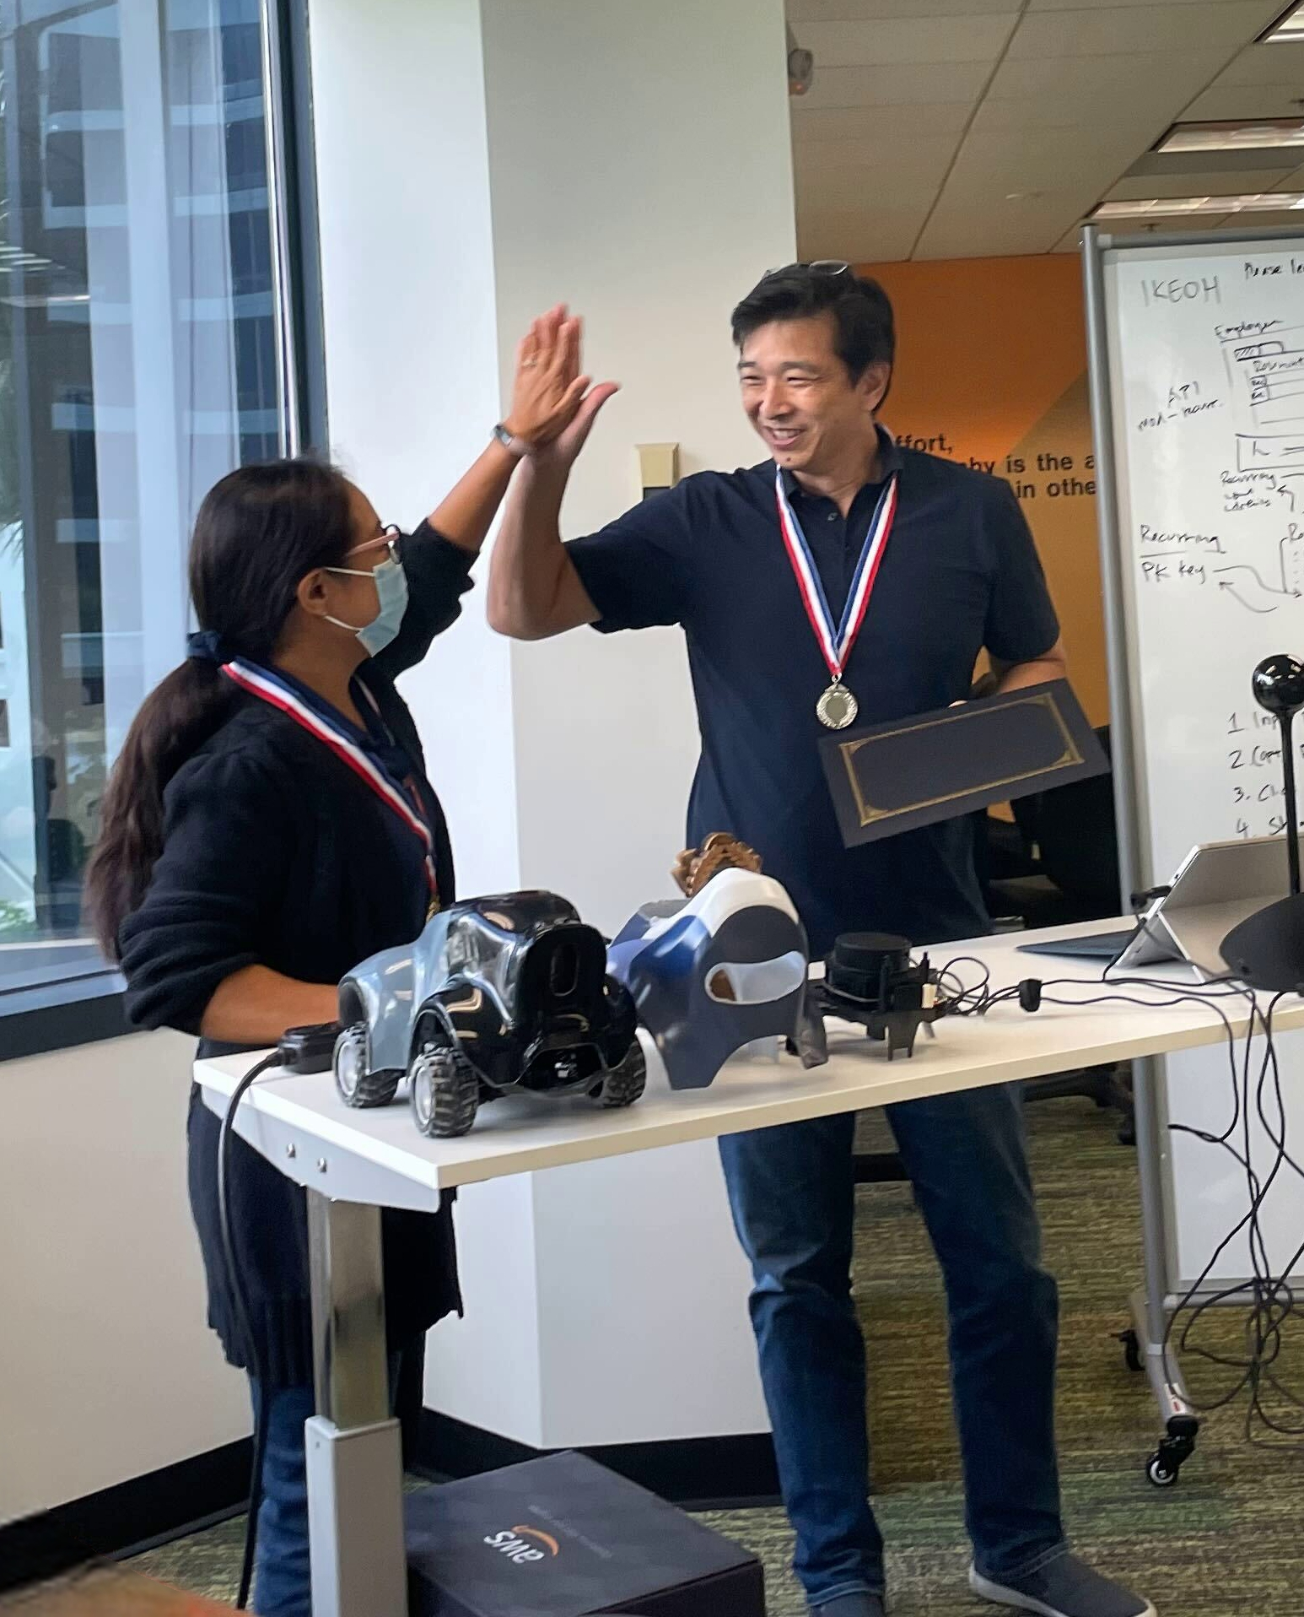
Step 7 –Celebrate
At the end of week 3, an award ceremony event was held
Prizes awarded to the top 3 fastest cars
Prize winners will be asked to share their winning tips for everyone to learn
AWS presented other ML services and use cases
Sent out a survey to get feedback

Slide 29
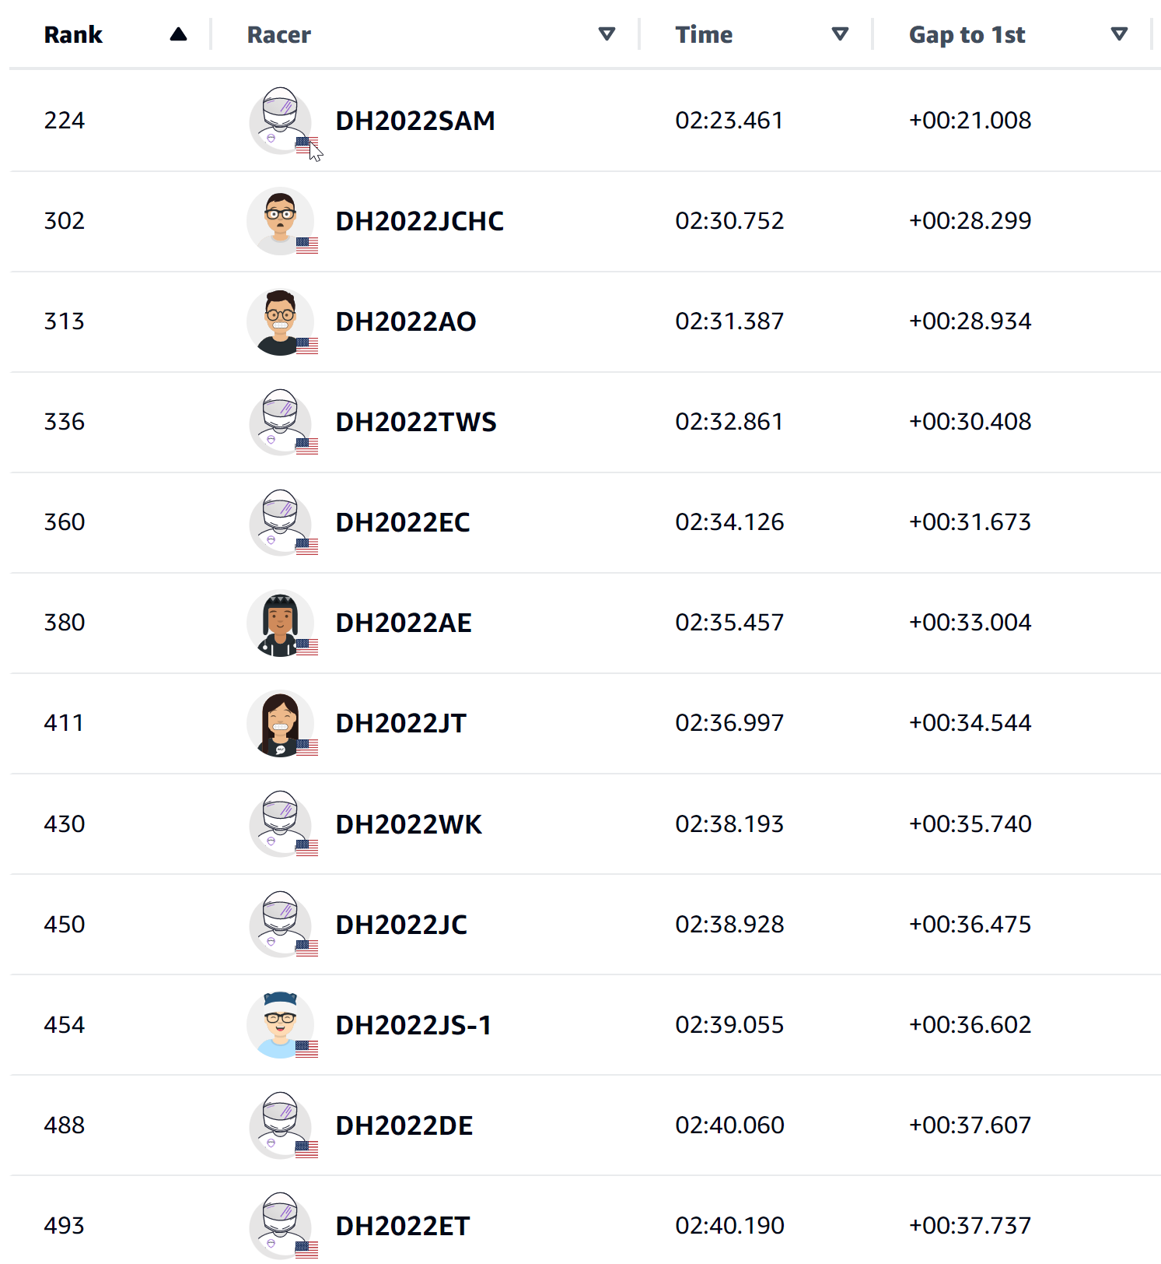
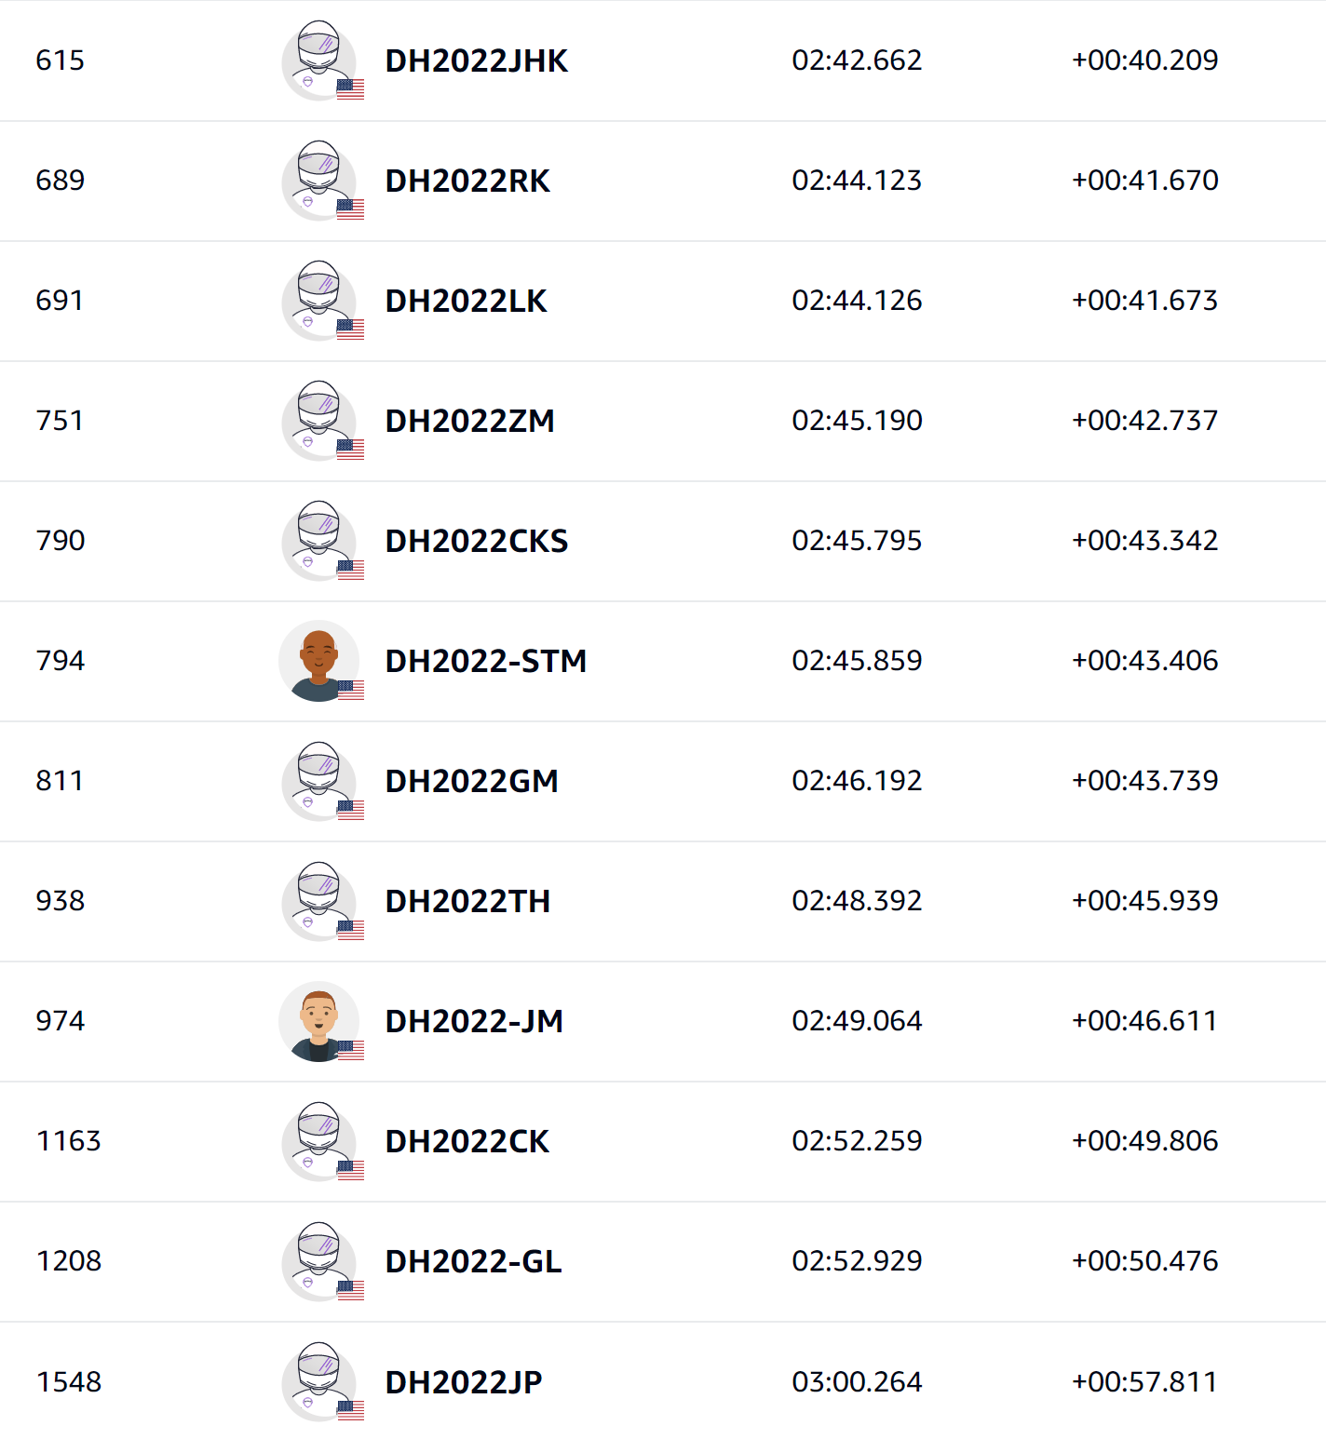
Results
45 participants in slack channel
Participants included staff, interns, and family members
24 race entries

Slide 30
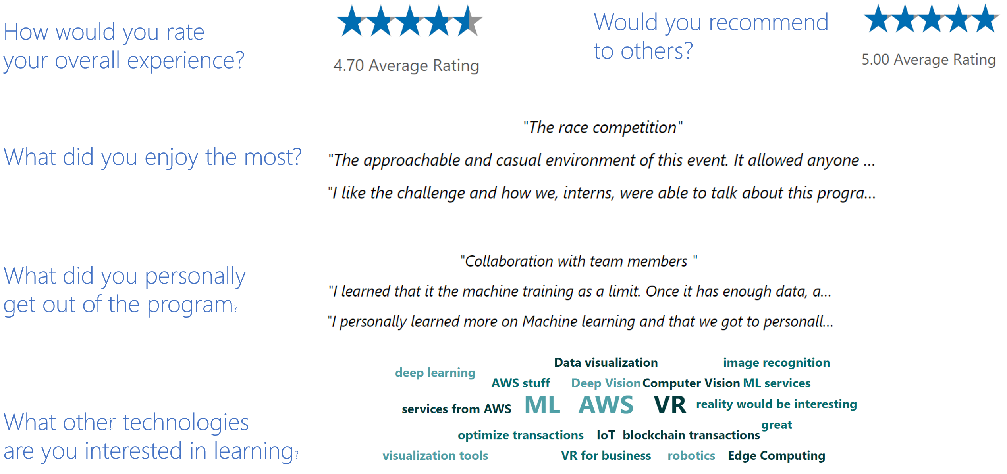
Participant Feedback

Slide 31
The Deep Racer program introduced an area of computing that’s new and unexpected to me. The performance of my overly-simplistic model is counterintuitive and has sparked an interest wanting to learn more. The use cases of AI/ML seem limited only by our imagination.
Program Manager

Slide 32
Fun experience to learn for both me and my husband who is more technically inclined (though he has never coded in Python before, so he had fun learning that as well)
Project Manager

Slide 33
I was able to receive free and easily digestible learning material of machine learning with an opportunity to apply it first-hand.
Software Developer

Slide 34


I feel more confident about machine learning concepts and Python.
The AWS Deep Racer was a great first project in this field.”
The AWS Deep Racer was a great first project in this field.”
The AWS Deep Racer was a great first project in this field.”
The AWS Deep Racer was a great first project in this field.
The AWS Deep Racer was a great first project in this field.”
Interns

Slide 35
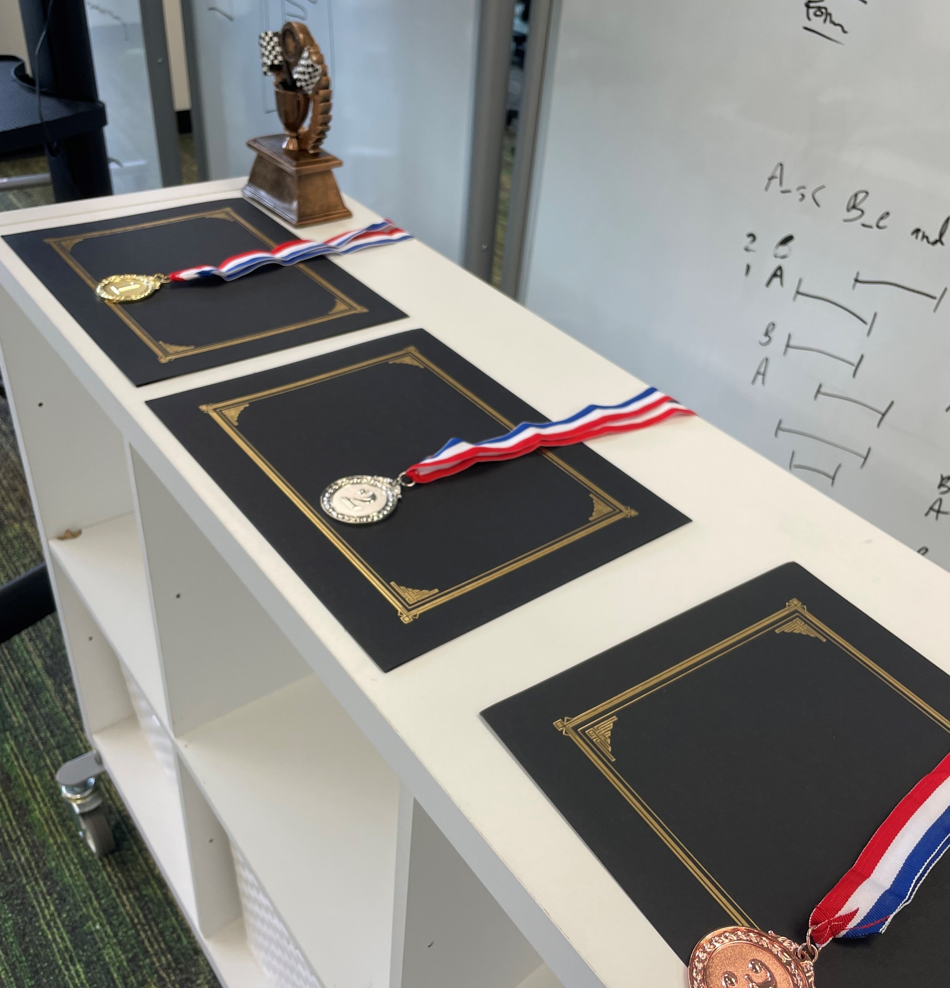
Summary of Tips
Start with Why
Make is easy and fun to encourage participation
Engage AWS experts share tips and AI/ML use cases
Get feedback from participants and planning committee
Collaborate with others to learn and share knowledge

Slide 36
Summary of Tips
Start with Why
Make is easy and fun to encourage participation
Engage AWS experts share tips and AI/ML use cases
Get feedback from participants and planning committee
Collaborate with others to learn and share knowledge

Slide 39

Feedback Please!
URL : https://eventbox.dev/survey/R1LIMRO
Clyde Shiigi | Chief Innovation Officer | DataHouse
Email : clyde_shiigi@datahouse.com
Nick Sciarrilli | Solutions Architect | AWS
Email : nsci@amazon.com

