Slide 1
Migrate & Modernize with AWS
Best solutions and services to help you
with your cloud journey
Stason Rodrigues
Rishabh Doshi
Jeff Masumoto
Solutions Architect
AWS
Manager, Solutions Architecture
AWS
VP Solutions & Consulting Services
DataHouse
Notes:
#cloudjourney

Slide 2
Drivers for transforming your business
Agility and
staff productivity
New customer experiences
Application
modernization
Security and
compliance
Scale globally
quickly, M&A
CIO
CSO
Application
portfolio
~1,000+ apps
VP BIG DATA
VP INFRA AND OPS
IoT and
AI/ML
Data
transformation
Scale globally
quickly, M&A
Digital contracts / supply chain
IT vendor
consolidation
Cost
reduction
Notes:
As we have enabled thousands of migrations to the cloud, and modernization of software, by customers, patterns of decisions being made, and drivers being considered, have emerged.
At the top level, we have learned a CIO owns an application portfolio that represents the business processes of the organization he or she serves. Often, in large enterprises, that portfolio can be 1000 applications. We have seen as large as 9000 applications in Banking and Telecom. For a mid market company, the portfolio might be 300. And for a small business, it might be 25-50.
But today we will focus on large enterprise portfolio lessons. There, there are 4 discernable decision patterns we have seen and are seeing.
First, the CIO who owns the business applications decisions. Here, the decision is develop in house, modernize an older app, or prioritize use of SaaS. Common priorities are consumer experience/taxpayer experience, or supply chain.
Second, is the CSO; As the CIO makes application priority decisions, the transformation or modernization of those apps, drives the modernization of security to a cloud first model. This means a complete revisit on older on prem approaches to security, a move away from hardware appliances, and a move to cloud models that use AWS accounts and organizations, and working with ISV’s who have approaches for security for a cloud world.
Third, is the VP of Big Data. She/he is receiving data streams like never before, the art of the possible on cloud is so much more flexible and scalable compared to on-premises that we see many companies make big data their second driver for use of public cloud, after developer productivity.
Finally, the VP or Director of Infra and Operations, has to go through substantial process and people skill change, as this team has to adopt new cloud first tools, abandon older tools, and move to a mixed world of ITSM for on prem apps that are moved to the cloud, and DevSecOps, for newer modernized apps using new tools across Serverless, Containers and SaaS. This team are modernizing their software tooling at a prolific pace, but also under pressure to reduce costs, while being more agile.

Slide 3
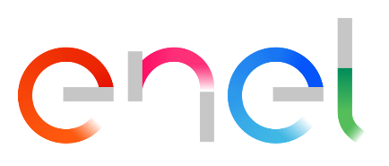


Why use AWS to migrate your workloads?
Most migration experience
Over a million active customers; leading brands migrate to AWS
Migrated ~5,500 instances in 9 months, reduced storage costs by 50% and compute costs by 20%, and sped up provisioning
10x from 4 weeks to 2 days
Most comprehensive and mature migration tools
AWS migration tools, as well as mature third-party migration tooling ecosystem to simplify and accelerate each step of the migration process
Migrated more than 600 workloads to AWS
in under 14 months, including some Unix to Linux conversions, driving year-over-year
cost reduction, and cut processing time from
36 hours to 10 seconds
Broad partner ecosystem
110+ Migration certified partners, ISVs, and system integrators to help customers assess, mobilize and execute their cloud migration
Most complete migration solutions
Set of programs and solutions to accelerate
your cloud journey
Releases over 50+ deployments per hour
Notes:
AWS has the most experience helping all types of organizations migrate to the cloud. AWS and our partner ecosystem have helped customers successfully migrate all types of workloads to AWS, including large-scale migrations of tens of thousands of servers.
Based on our years of migration experience, we developed the methodology, best practices, tools, and services to help simplify and accelerate migrations.
With automation and data-driven guidance, AWS simplifies each step of the migration process, reducing the effort and complexity involved. This helps accelerate your migrations by reducing the time to realize the value of your cloud migration.
------------------------------------------

Slide 4
Benefits as seen across thousands of migrations
31%
43%
Average infrastructure cost savings
Fewer security
incidents per year
62%
3x
IT staff
productivity boost
More features delivered per year
Sources: IDC, Nucleus Research, AWS Analysis
Notes:
Across hundreds and thousands of customers, we see a repeated pattern of economic pay back to these migrations.
Often with our AWS variety of compute instances, our Nitro architecture approach to off-loading network and storage work from the CPU, resulting in fewer cores used to host workloads, and reduce licensing costs running in the cloud.
The switch to a cloud based security model often results in fewer security incidents.
And the shift to both DevOps, using modern tools, and to Serverless, where we automate more of the operations means substantial productivity boosts. Companies like Aon saying that time to innovation shortens and more features get released.

Slide 5
Three keys to migration and modernization success
Notes:
So what have we learned, that we can pass on to you to help you make better decisions?
AWS set up a Professional Services Migration Services Practice in the US NE in 2015, and then expanded that to a global center of excellence in 2016.
We then established a Migration Services Engineering team in 2016, and now have hundreds of engineers building tools to simplify the art of migration and modernization around AWS Migration Hub
And we introduced programs like Migration Acceleration Program, MAP, to accompany best practices and tools with economic incentives for customers and partners
We have instituted data analysis of projects to draw new insights and pass them on to you today.

Slide 6
Make a Plan for your application portfolio
Build An
Operating Model
&
A Service management framework
Don’t do
it alone!
Use an experienced
partner
Notes:
Looking at data from over 1,200 migrations this year we have observed 3-4 key patterns for you to think about and embrace. We see successful transformations exhibit these three key behaviors.
Approaching your application portfolio, and prioritizing certain applications and having an overall plan is the first.
As you use the cloud more and more, you design a new ‘operating model’ and you end up with a combination of tools. Our customers call this a Service Management Framework. We have over 100 partners who are ISV tool partners to allow you to frame your needs and your tool preferences in context of AWS tooling.
And finally, data analysis shows that where customers use a consulting partner – whether one of over 100 AWS migration certified partners or AWS professional services – customers are 16% more successful, and also have 25% faster time to completion of their migration and modernization projects.
Let’s dive into each of these to see what we learned.

Slide 7
Make a Plan for your application portfolio
Build An
Operating Model
&
A Service management framework
Don’t do
it alone!
Use an experienced
partner
Notes:
Looking at data from over 1,200 migrations this year we have observed 3-4 key patterns for you to think about and embrace. We see successful transformations exhibit these three key behaviors.
Approaching your application portfolio, and prioritizing certain applications and having an overall plan is the first.
As you use the cloud more and more, you design a new ‘operating model’ and you end up with a combination of tools. Our customers call this a Service Management Framework. We have over 100 partners who are ISV tool partners to allow you to frame your needs and your tool preferences in context of AWS tooling.
And finally, data analysis shows that where customers use a consulting partner – whether one of over 100 AWS migration certified partners or AWS professional services – customers are 16% more successful, and also have 25% faster time to completion of their migration and modernization projects.
Let’s dive into each of these to see what we learned.

Slide 8
Make a plan for your application portfolio
Reduce the size of your estate*
Move to AWS
Transform on AWS
Lift & shift
Retire
10%+
Modernize
Serverless / containers / microservices
50%
SaaS
20%
20%
Re-platform
Notes:
From analyzing over 1000 migrations we can see clear patterns
First, many customers are realizing that they have many older apps that many not even relate well to the future business model; they can be retired –data indicates 10-20% of the app portfolio can be retired.
Second, there are now thousands of SaaS vendors who didn’t exist 5-7 years ago, and so a number of on premise apps can be replaced by SaaS vendors
Most large customers have landed on Salesforce, as a CRM platform for example, but for many other apps built on top.
This shift to SaaS shrinks down the operational portfolio managed by IT Operations – it still presents Security and Identity work, but less operations costs.
Then decisions can be made to lift and shift, and during a move, re-platform OS or Database, or language to reduce costs. We see more and more customers re-platforming from Windows Server to Linux, and from Oracle to Postgres/Aurora to reduce database licensing costs.
And finally you can choose to modernize. However, the key lesson we have learned here is that customers should focus on modernizing apps that are true differentiators to your business first.
We see transformation and modernization get applied to at least 20% of the portfolio over time. Some in-house, with IT, and some outsourced to key partners.

Slide 9

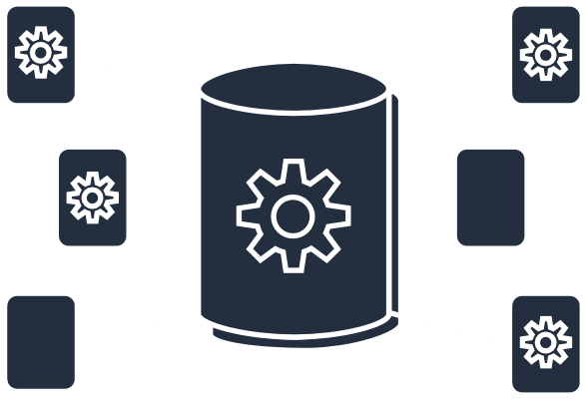

Migrate and modernize legacy applications
Migrate to
free-up resources
Shift licensing and cost models to the cloud
Scale infrastructure on demand
Leverage your data with
advanced analytics
Innovate with
200+ cloud native services
Boost skills and experience for speed and agility
Notes:
Why workload renovation?
We want to build a long term plan with our customers to assess all of their critical enterprise applications, help them understand their potential in the AWS cloud and design a strategy for not just migrating them to the cloud but also for modernizing them to unlock the business value. Migration and Modernization are not disconnected things and are not one-time events. Migration and scale are the obvious benefits…but have you considered all of the potential value of unlocking your business data using the processing power of the cloud and advancements in AI/ML and data lakes?
We want to partner with you on a renovation plan to drive a complete transformation that will help you build an environment of innovation…and that spans people, process, tools and services.

Slide 10



Benefits of modernizing legacy workloads
MAINFRAME
442%
projected 5-year ROI running Windows on AWS
5000+
Active customers running SAP on AWS
43%
Reduction in IT infrastructure costs with VMware Cloud on AWS
350,000+
Databases migrated to AWS
70%+
Reduction in IT infrastructure costs with AWS
Source: IDC, Windows Server Operating Environment Market Update, Doc # US44217118, August 2018
Source: IDC Business Value White Paper, sponsored by Amazon Web Services, The Business Value of VMware Cloud on AWS for Supporting Business-Critical Applications, doc #US46974120, January 2021
Source: IDC Business Value White Paper, The Business Value of Efficiently Running High-Performing Windows Workloads in AWS Cloud, 2019
Notes:
Were you aware that these workloads can run on AWS? And in many cases more efficiently? With better scale and reliability? And lower costs? And by doing so opens up opportunities for your business to be more agile and innovate?
We’ve worked with thousands of customers across the globe on workload renovation strategies to transform their business and through that experience developed tools, services and programs that have made AWS the cloud provider of choice for these strategic workloads
Microsoft – AWS hosts 2x more Windows Server instances than any other cloud provider
SAP – more than 5000 customers are running SAP on AWS today
Vmware – our exclusive partnership with Vmware has helped 100’s of customers reduce infra costs by over 40%
Oracle – over 350,000 databases have been migrated to AWS including Oracle
Mainframe – mainframe cost savings average over 70%

Slide 11
Application migration workflow
Migration plan (Backlog)
Migrate
Track
Migration waves
Adopt most suitable
patterns based on migration plan
Select the right AWS and partner tools
Migrate
application
Track application performance
Continue migrating applications in waves

Slide 12
Proven application migration customer journey
ASSESS
MOBILIZE
MIGRATE & MODERNIZE
Migration Evaluator
Rapid migration business case (RMBC)
Migrate
Discovery and planning
Business
case
Migration
plan
Landing
Zone
Rapid discovery
TCO report
Pre-MRP accelerators
Operate
Briefings & workshops
Immersion
day
Security & compliance
Operating
model
Migration experience
Skills / center
of excellence
Modernize
Create a case for change
Mobilization through experiences
Accelerate migration at scale
Notes:
Successful customers create momentum early – they don’t get caught up in planning and inaction.
In 2020, we have a very different story than 5 years ago when we set up our migration services practice in the NE led by Director Matt Collins.
We have updated our thinking into Assess, Mobilize and Migration and Modernize as phases.
In the Assessment phase, we have worked to make it easy to assess more quickly and make inform decisions. Assessments can be done in days, and weeks.
On the getting ready phase, we call this Mobilize. They key to Mobilize, is to start, learn and repeat. Our Services teams can enable Assessment, Landing Zone and first 10 apps migrated in under 90 days.
To compress time to success, we’ve built Control Tower. This allows you to set up a secure landing zone in days, or hours, whereas in the past it was weeks and months. THere we hare automating the set-up of a secured environment on AWS with Control Tower, and Service Catalog. And we can do his now in hours and days, rather than weeks and months.

Slide 13




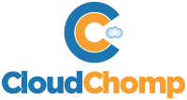
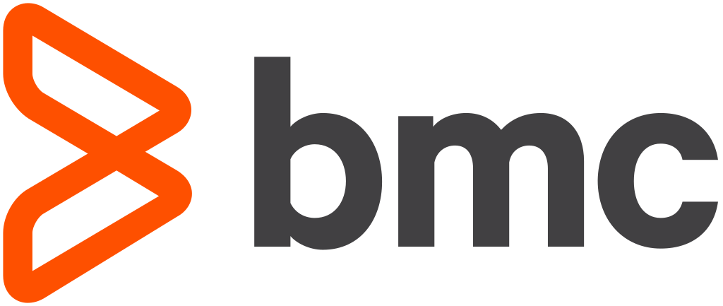
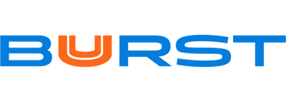



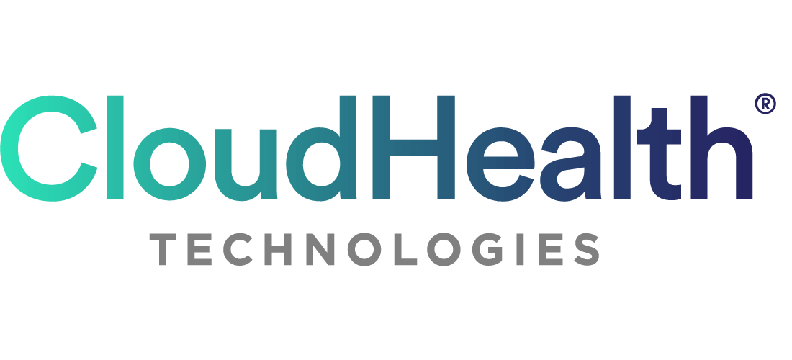

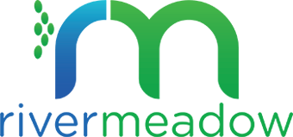












Rich toolset to support each phase of migration
Assess
Mobilize
Migrate &
Modernize
Operate
AND Optimize
INVENTORY
BUSINESS
CASE
DEEP
DISCOVERY
PLANNING
LANDING ZONE
WORKLOAD AND DATA MIGRATION
OPERATIONS
CloudEndure Migration
Migration
Evaluator
Migration
Evaluator
AWS
AWS Application Discovery Service
AWS Control Tower
AWS Server
Migration Service
AWS Application Discovery Service
AWS DataSync
AWS
Management & Governance Services
AWS Application Discovery Service
Migration Portfolio Assessment
AWS Database
Migration Service
Migration Portfolio Assessment
AWS Service Catalog
AWS Migration Hub
Partners
PROFILING & VALIDATION
PROFILING & VALIDATION
PROFILING & VALIDATION
Partner migration tools found on
Notes:
With re:Invent 2020, we now have the broadest set of tools ever to simplify Migrations.
I want to highlight 3 significant changes since last reinvent.
Migration Evaluator: we have taken our 2019 acquisition of TSO Logic, which we announced last year and have launched it globally as a customer accessible web site experience called Migration Evaluator. Customers, or their partners, can initiate a fast first directional business case exercise for moving an app from on-prem to AWS and look at cost savings across Windows Server and SQL Server.
Application Discovery Service now has released a Network Dependency model that captures and shows the network resources that make up an application.
We are expanding global footprint of migration tools. We just expanded the global footprint of Control Tower, and rolled it out to 5 more regions last week, including LHR and ARN to now cover 10 regions in total.
We also rolled out AWS Migration Hub to 6 more regions across APAC and EMEA and introduced better visibility to migrated applications and their resources once moved.

Slide 14
AWS Marketplace provides 7,000+ software products for provisioning to simplify modernization
Consulting Partner private offers;
Private Marketplace UI
Private Marketplace APIs; managed entitlements; Professional Services in AWS Marketplace
Catalog API
AMIs
Data exchange
2016
2018
2020 – re:Invent
2012
SaaS
2017
Containers; ML
2019
Find, buy & deploy
Private offers; SaaS contracts API
AWS Marketplace in 6 AWS consoles; procurement system integration; discovery API
Deployment types
Notes:
During modernization, we are seeing many companies want to modernize the subscription and provisioning and tracking of third party software.
Marketplace is our service to make it easy for the discovery, contracting and provisioning of software during this transformation, modernization and governance exercise.
PAUSE
And I am pleased to announce several new capabilities on Marketplace, to simplify modernization.
In particular, effective today, customers can now procure professional services, from over 100 suppliers on Marketplace. – Consulting partners and ISVs.
And we have integrated Marketplace into AWS License Manager, so that software entitlements can be distributed across accounts easily.
And we are releasing new Private Marketplace APIs’s, so that customers can more easily govern the products and vendors made available to their development teams.

Slide 15
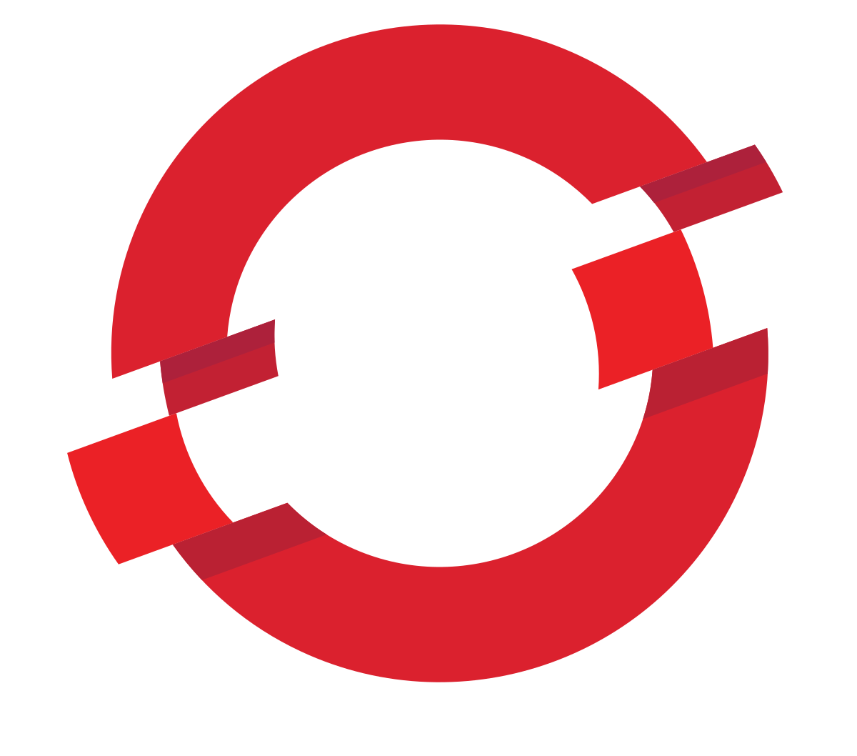


AWS services addressing the on-premises to cloud phase
create a seamless experience across the edge, on-premises, and in the cloud
VMware Cloud
on AWS
AWS Outposts
Amazon RDS
on VMWare
EKS Anywhere
EKS Distro
ECS Anywhere
Red Hat
Open Shift
on AWS (ROSA)
AWS Snow Family
AWS Storage
Gateway
AWS
DataSync
AWS Transfer
for SFTP
Systems Manager
CloudWatch
Management & Governance
Data transfer
Notes:
We have also taken feedback from at least 5 vertical industries, that while migration to the cloud can be done in as little as 8 months for a mid-market company with 200 applications, many large customers in sectors such as Financial Services, Public Sector and Healthcare envision an on-premises to cloud transition state to last for several years.
Why is this? The sheer size of the in-house developed application portfolio is the main reason. These industries have immense application portfolios. And many of them of them still use Mainframes for up to 10% of their applications.
Hence, we are rolling out a set of offer consistent infrastructure, services, APIs, management and tool across cloud and on premises and the edge so that developers and operations teams can have common tools.
From bringing VMWare onto AWS with VMC, to the shipping of Outposts on-premises, and now Andy’s announcement of EKS Anywhere, and ECS Anywhere, and our recent partnership to put Red Hat OpenShift on AWS, these are responses to our customers asks for environment commonality that makes cloud migration easier, and reduces training and application change costs for our customers.
On the Data Transfer level, we make this easier and easier. For example, we launched Snow Ball as a data migration tool but find half our snowballs stay on premises as permanent subsystems with an AWS environment on them.
And now as I will discuss, we are making it easier on the Systems Management and Monitoring aspects too to monitor and manage on-prem resources

Slide 16
Make a Plan for your application portfolio
Build An
Operating Model
&
A Service management framework
Don’t do
it alone!
Use an experienced
partner
Notes:
Looking at data from over 1,200 migrations this year we have observed 3-4 key patterns for you to think about and embrace. We see successful transformations exhibit these three key behaviors.
Approaching your application portfolio, and prioritizing certain applications and having an overall plan is the first.
As you use the cloud more and more, you design a new ‘operating model’ and you end up with a combination of tools. Our customers call this a Service Management Framework. We have over 100 partners who are ISV tool partners to allow you to frame your needs and your tool preferences in context of AWS tooling.
And finally, data analysis shows that where customers use a consulting partner – whether one of over 100 AWS migration certified partners or AWS professional services – customers are 16% more successful, and also have 25% faster time to completion of their migration and modernization projects.
Let’s dive into each of these to see what we learned.

Slide 17
Select one or more operating models for your cloud
Self-managed
AWS Managed Services (AMS)
Partner-managed
AWS Service Catalog
AWS Systems Manager
AWS management tools and services
  Modeling and provisioning
  Automation and operations
  Monitoring and logging
Third-party tools
100+ Managed
Service Partners (MSP)
Certification program
Third-party audit
Full lifecycle services
Out-of-the-box cloud operating model
Addresses security and compliance operations
Managed AWS Landing Zone
Self-service automation
7x24 Worldwide AWS Operations Support Engineers
“Month-to-month” terms
Click here to learn more
Notes:
Customers use their first few application migrations to develop a foundation and operating model that will continually improve and become more sophisticated as your migration accelerates.
Once workloads are in AWS there are 3 operating models to choose from
You can use AWS Management and Governance services for end-to-end IT lifecycle management for both your AWS and non-AWS resources.
AWS Managed Services (AMS) can also help you accelerate your migration by providing ongoing management, cost optimization, and operations of your AWS infrastructure, leaving your team free to focus on your applications and build their skills in the cloud.
You can also chose to partner with one of over 100 AWS Managed Service Providers who provide full lifecycle services for cloud operations. The MSP partners are qualified through an MSP certification program and are audited by third-parties for compliance
And of course you can use multiple of these options to best fit your needs.
------------------------------------------

Slide 18
Identify technical / IT domains to modernize for better automation and governance
Virtual machine formats, OS standards & patch management
Security, identity,
and network
Storage and
database tools
Monitoring and control mechanisms
Training and learning new skillsets & tools
AWS enables faster cloud adoption by removing barriers
Notes:
As we aid hundreds and thousands of customers migrate and modernize, we note that specific IT domains, require substantial re-design and modernization. This modernization covers:
Developer OS environments as first – these affect patch management
Security Network and Identity are next and offer great opportunity for scalability, resilience and cost reduction.
After that comes storage, back up and database tools
And as more apps move to the cloud, customers modernize monitoring and management tools
All these require training and re-skilling
Promote a cloud-first approach
For example, culling out older operating systems, and standardizing on few OS’s – such as Red Hat Linux, Amazon Linux, Windows Server and perhaps a SUSE, a Centos or a Debian, to minimize change management variable
A modernization of the network to pivot to modern network topologies where more of the network is on the AWS cloud, and the on premises assets get mapped into a Software Defined WAN - SDWAN

Slide 19
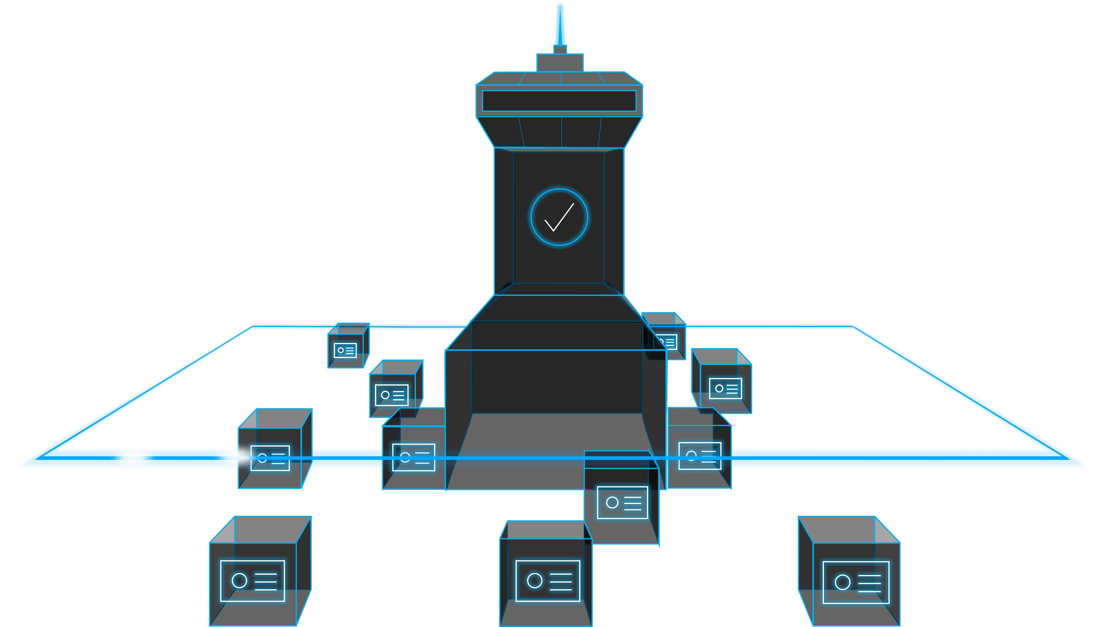
Create your environment on AWS to get started
Mobilize
Set up environment
Enable control
YOUR AWS RESOURCES ARE GROWING OVER TIME
YOUR AWS RESOURCES ARE GROWING OVER TIME
Improve
over time
Manage accounts
and policies
Establish
cost controls
AWS Control Tower
Click here to learn more
Notes:
With AWS Control Tower you can set up an AWS multi-account environment or “landing zone”
AWS Control Tower provides the easiest way to set up and govern a new, secure, multi-account AWS environment based on best practices established through AWS’ experience working with thousands of enterprises
you can provision new AWS accounts in a few clicks knowing your accounts will conform to your company-wide policies.
If you are building a new AWS environment, starting out on your journey to AWS, starting a new cloud initiative, or are completely new to AWS, Control Tower will help you get started quickly with governance and best practices built-in
Link: https://aws.amazon.com/controltower/
-----------------------------------------

Slide 20





AWS management and governance automation services enable an operating model
Set up governance
Enable compliance
Provision & orchestrate
Monitor & observe
Centralize operations
AWS
Control Tower
AWS
CloudTrail
NEW!
NEW!
Amazon
CloudWatch
AWS Systems
Manager
AWS
Proton
AWS Distro
for OpenTelemetry
AWS
Organizations
AWS Well-
Architected Tool
AWS
License Manager
AWS
Marketplace
AWS
CloudFormation
AWS
X-Ray
AWS
Cost Explorer
AWS
Budgets
AWS
Config
AWS
Managed
Services
AWS
Service Catalog
AWS Cost and
Usage Report
Notes:
Over the last 12 years, we he built 21 services in what we call our Management and Governance services portfolio. My colleague Bill Vass, will be providing a broad update on many parts of this portfolio on December 15th, so I do encourage you to attend his session. We don’t have time to day to cover it all – he has his own 1 hour talk.
From a migration and modernization point of view, what does matter here, is for you our customers to understand we are innovating constantly to build the tools to let you set up a governed set of accounts and resources – with Control Tower and organizations, to provision infrastructure and code with Service Catalog, Cloud Formation and Marketplace, and to monitor and observe with Cloud Watch and CloudTrail, and to allow operations management and
From the set up and governance of accounts and resources, to the provisioning of infrastructure and applications, to monitoring and observability, and to some form of centralized operations of infra, but distributed management of applications. Bill Vass, my colleague, and our VP of Management Tools will be covering more of this on December 15th, but today I do want to talk about a couple of new capabilities that can help accelerate migrations and simplify governance.

Slide 21
Make a Plan for your application portfolio
Build An
Operating Model
&
A Service management framework
Don’t do
it alone!
Use an experienced
partner
Notes:
Looking at data from over 1,200 migrations this year we have observed 3-4 key patterns for you to think about and embrace. We see successful transformations exhibit these three key behaviors.
Approaching your application portfolio, and prioritizing certain applications and having an overall plan is the first.
As you use the cloud more and more, you design a new ‘operating model’ and you end up with a combination of tools. Our customers call this a Service Management Framework. We have over 100 partners who are ISV tool partners to allow you to frame your needs and your tool preferences in context of AWS tooling.
And finally, data analysis shows that where customers use a consulting partner – whether one of over 100 AWS migration certified partners or AWS professional services – customers are 16% more successful, and also have 25% faster time to completion of their migration and modernization projects.
Let’s dive into each of these to see what we learned.

Slide 22
Why involve a partner?
Reach desired
business
outcome faster
Reduce your
operational costs
Focus on
innovation
Reduce security
and compliance risk
Develop
your skills
Notes:
From studying our 1200 cohort of Migrations, we’ve seen some patterns in the use of consulting partners.
First and foremost ,our data shows that customers who use a consulting partner, get their migrations done 25% faster. This isn’t just due to the participating in change management, but because they bring experience.
It gets customers to desired business outcomes faster. The skills gap is the single biggest obstacle to customers innovating at pace – which enables them to stay relevant and capitalize on market opportunities.
In many instances, the customer’s IT team has been busy keeping the lights on and has not had the time or resources to invest in upskilling to accommodate the rapidly changing needs of the business.
Another dimension we observe, is that during migration and modernization, IT departments choose to not want to do some work – whether it be infra management, or network modernization, or application development. A partner can offload the undesired work.
AWS and consulting partners bring compliance and control tools and expertise. We have dozens of vendors now integrating into AWS Security Hub and AWS Control Tower, and consulting firms can implement controls and guardrails specific to industry.
And all this frees up you, the customer, to focus on the skills you want to develop

Slide 23



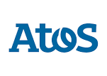





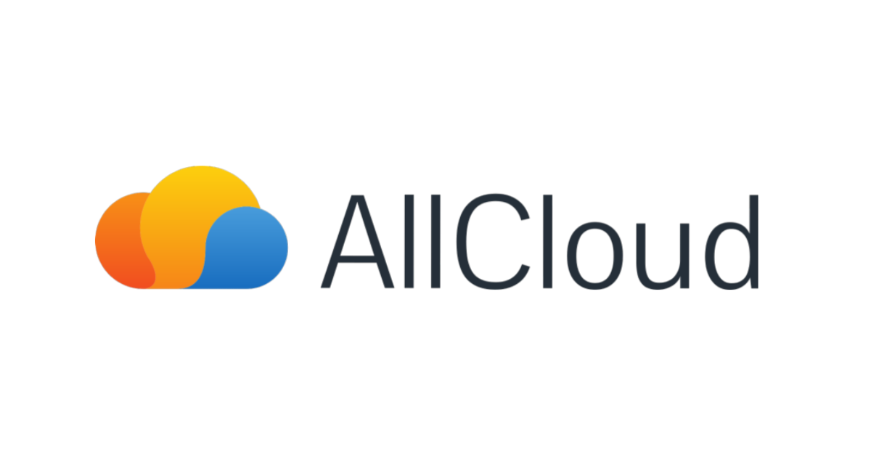






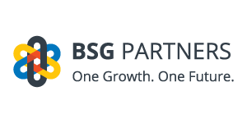


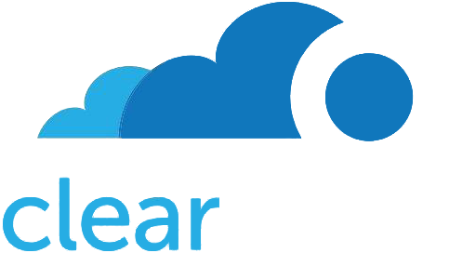





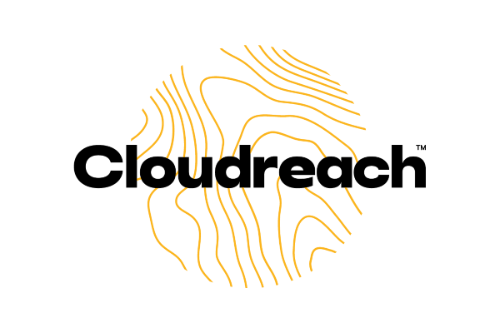
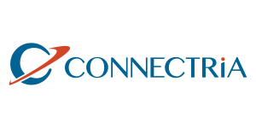

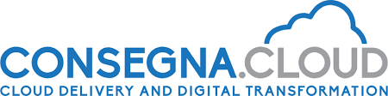






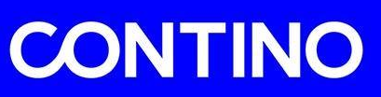
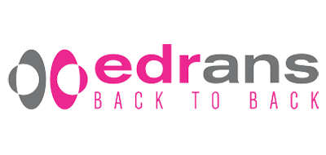
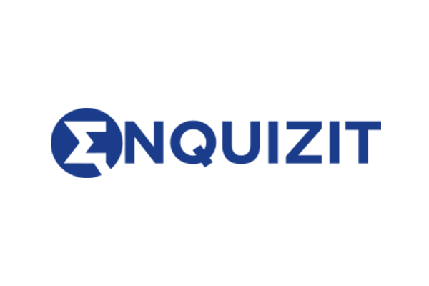




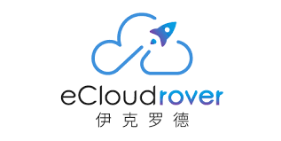

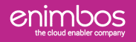
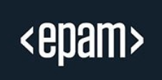
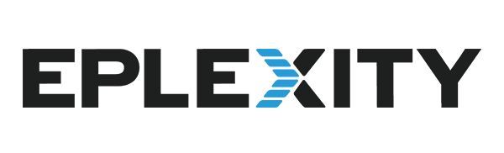
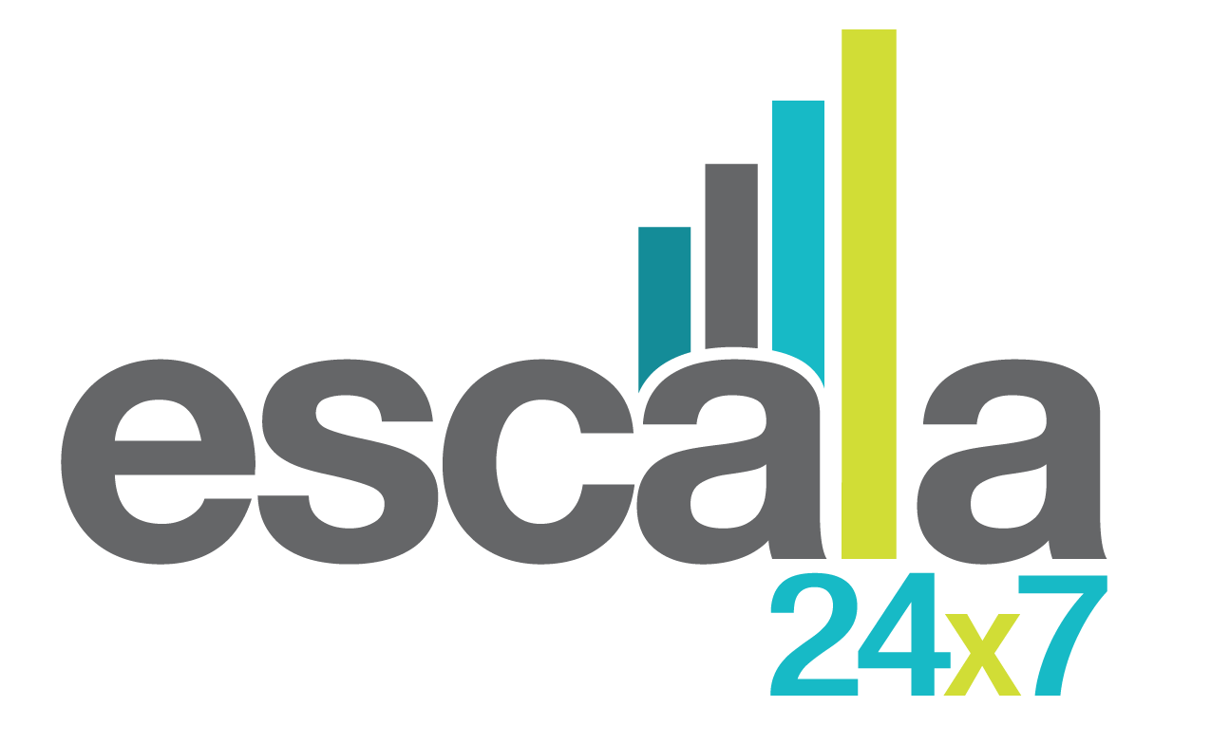






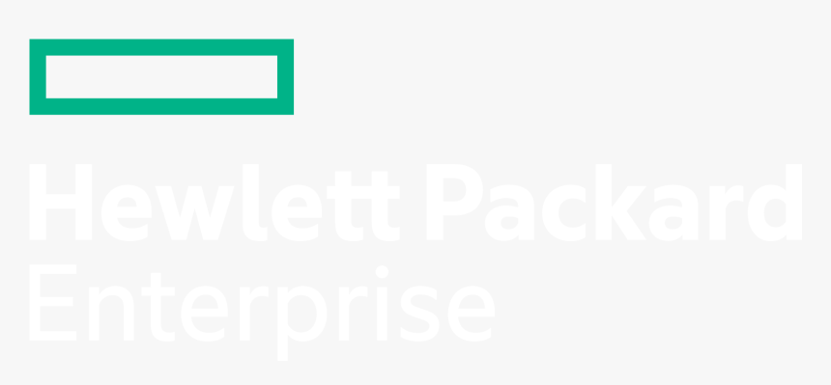
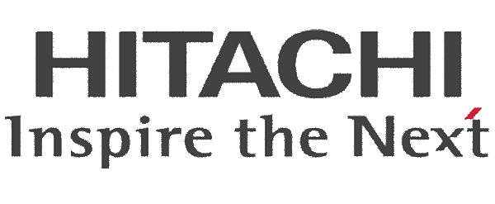
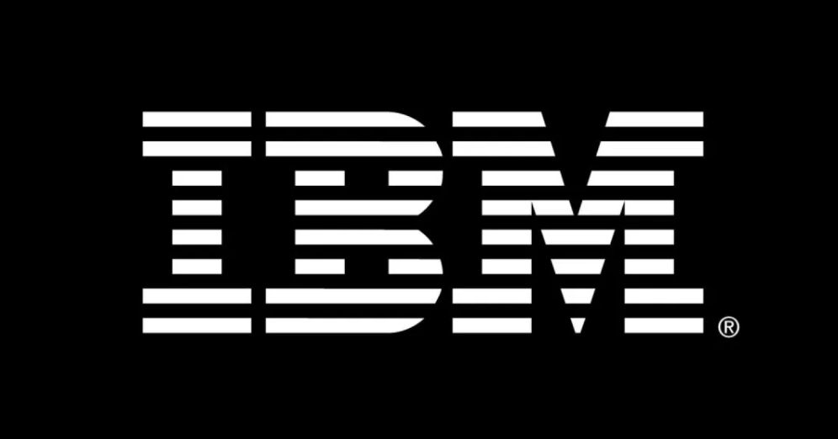
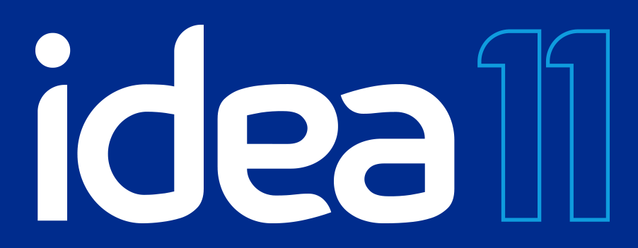

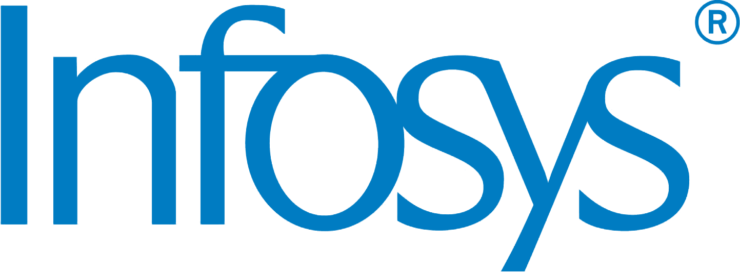

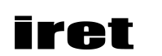

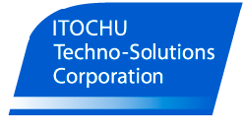



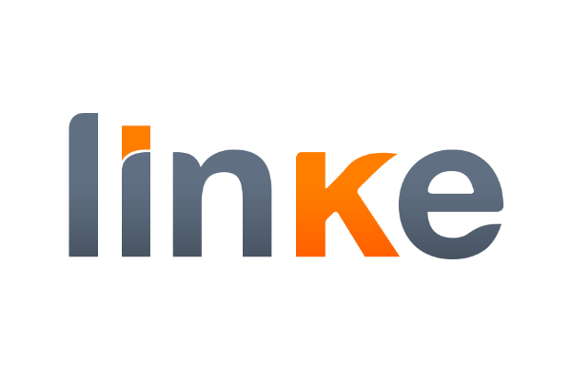


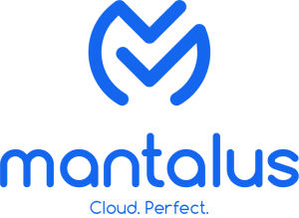






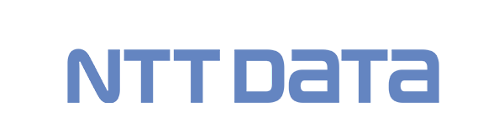




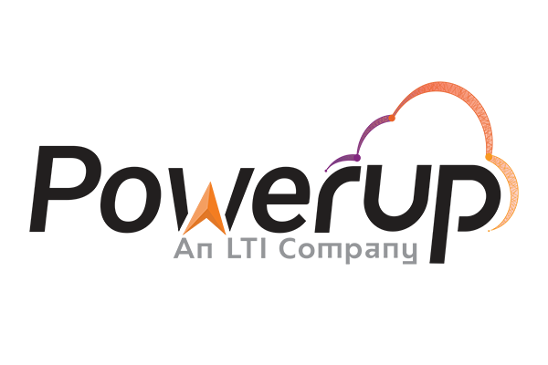
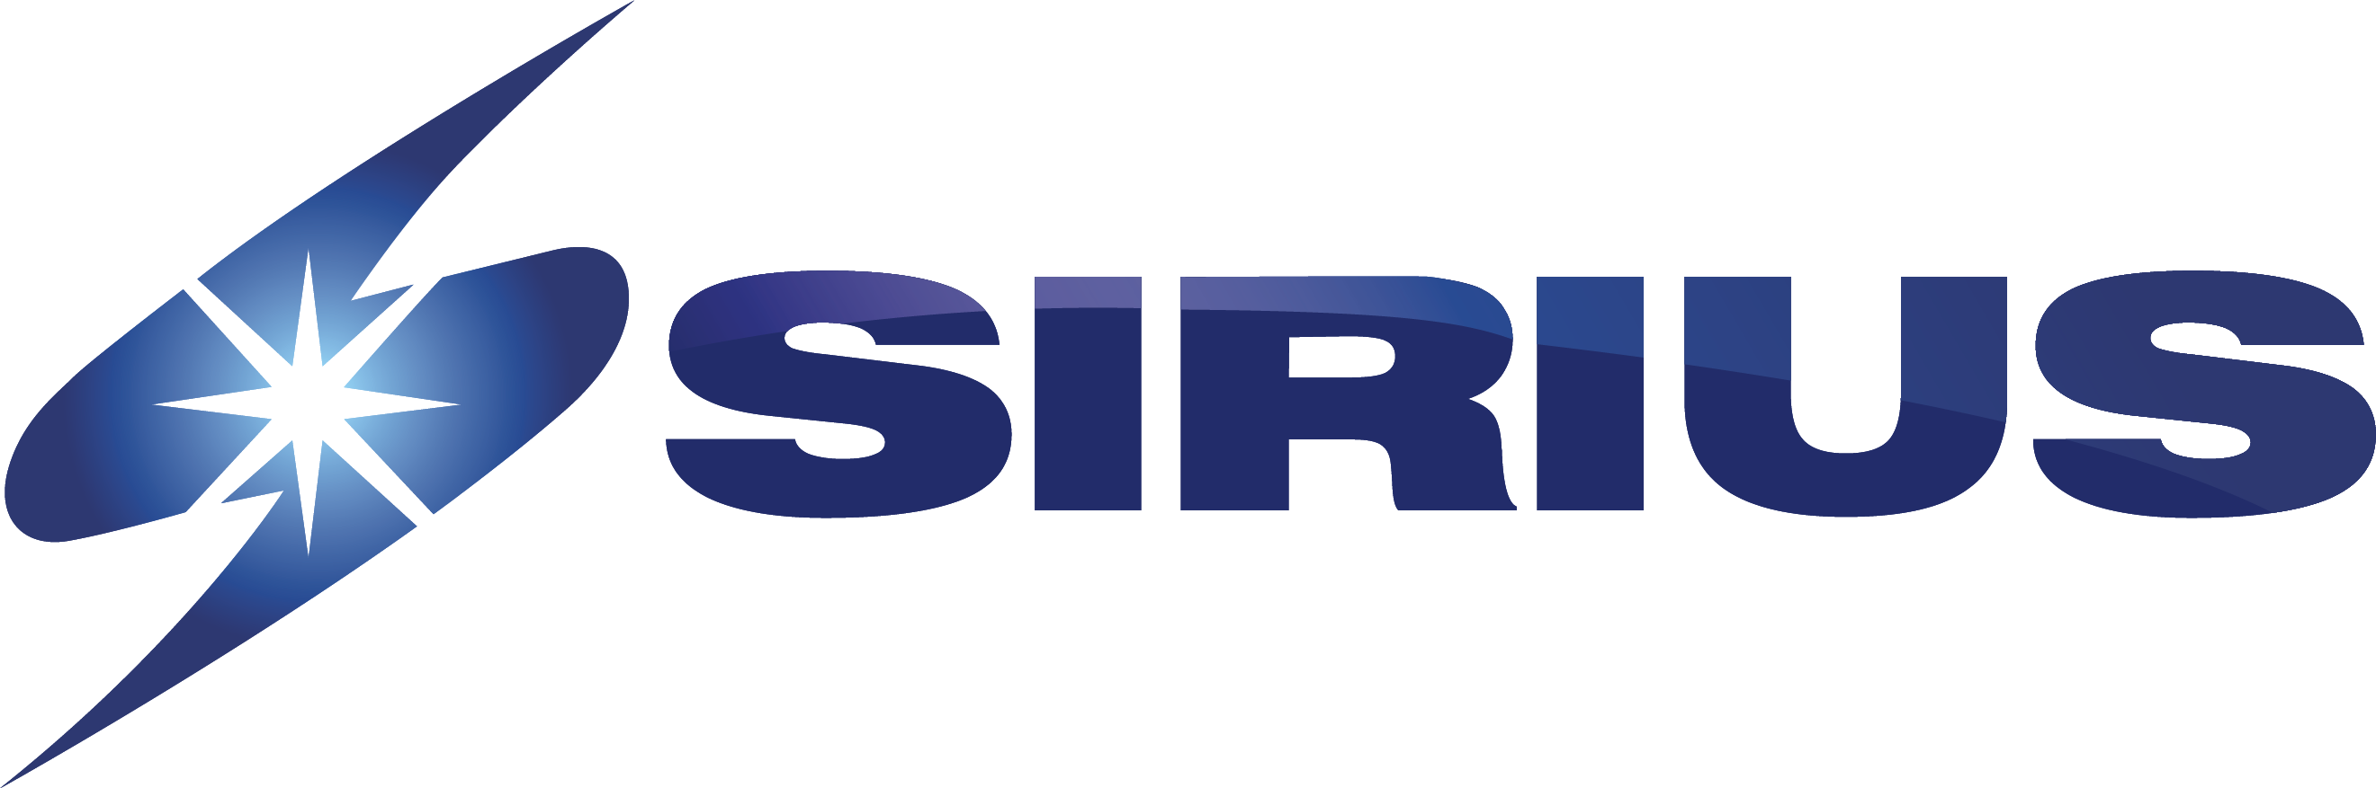







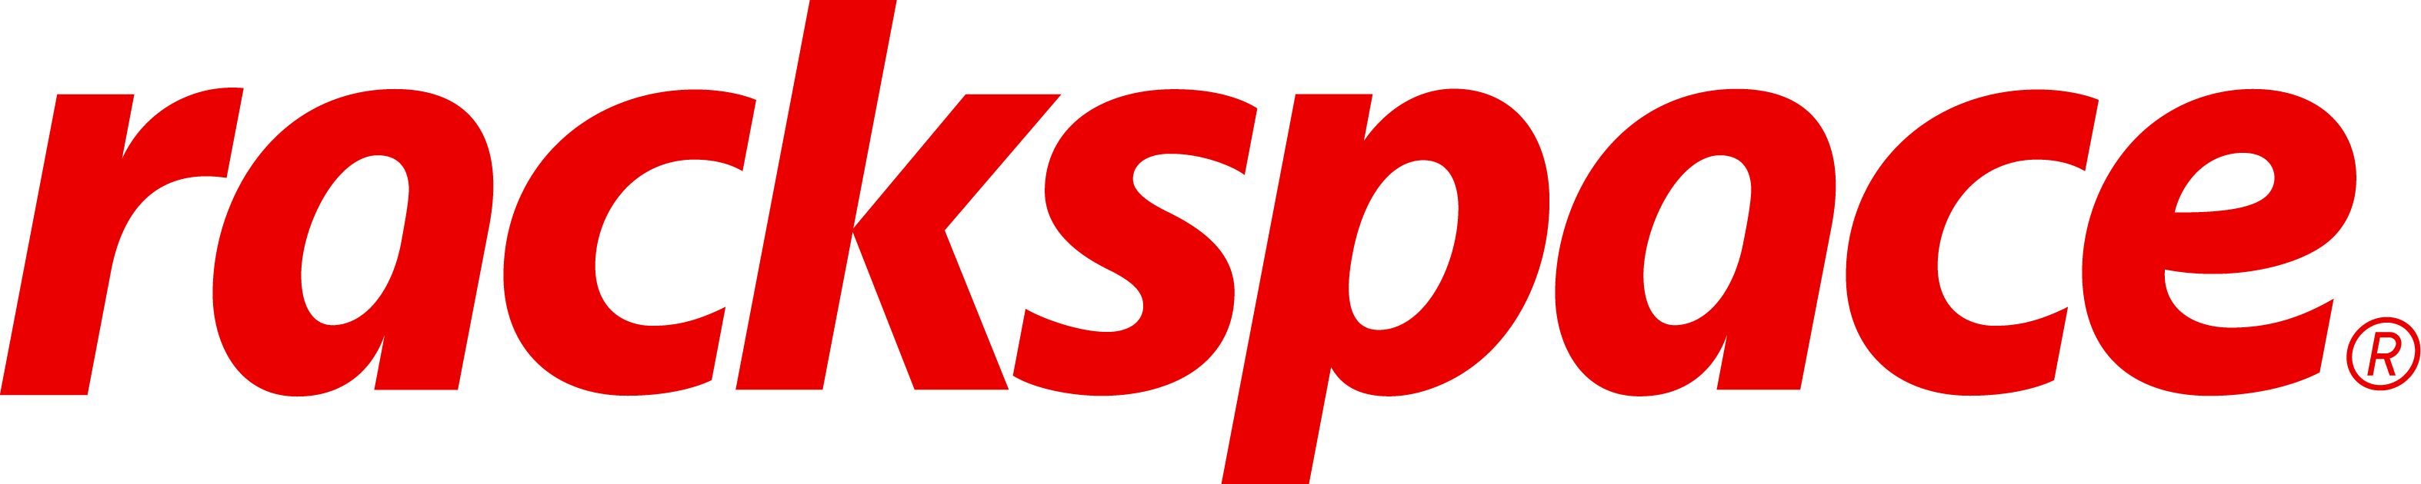
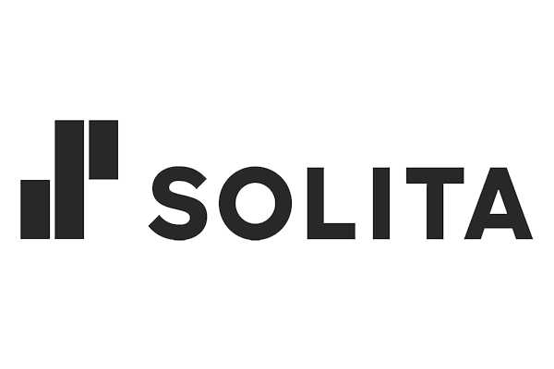
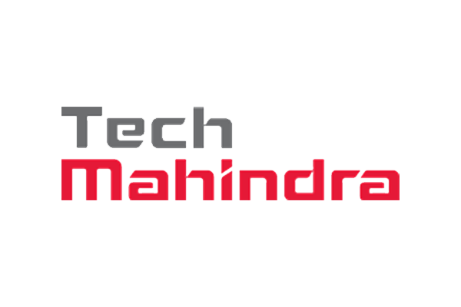
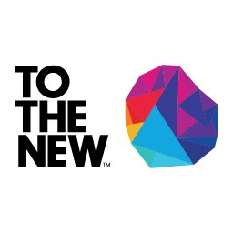

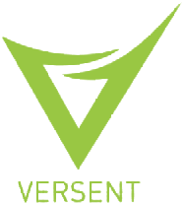




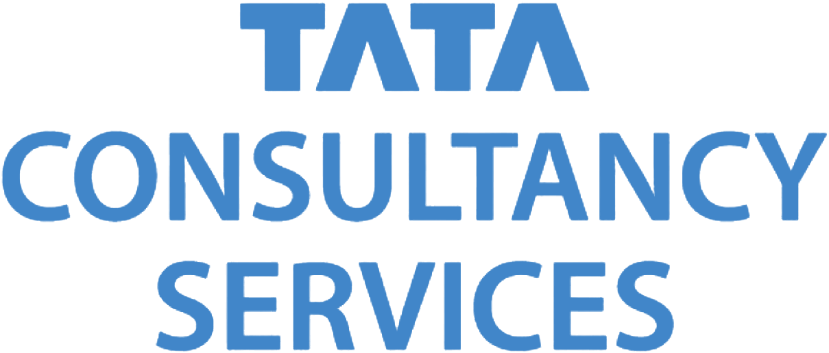
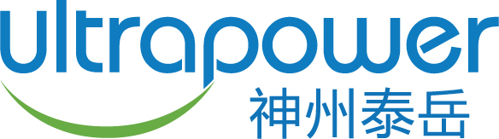
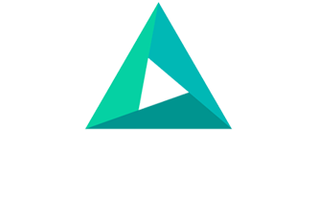




AWS Migration Competency Partners now exceed 240
AWS Migration Competency Partners (240+)
At least advanced-level AWS Consulting Partner
Established AWS migration practice
AWS certifications and certified consultants
Notes:
We have certified over 240 AWS Migration Competency partners that can help you with your migration journey. These partners have large migration practices and experience delivering large-scale migration projects.
So as you start your portfolio analysis, bring in an expert who has done it before
Customers tell us they want us to introduce partners who are skilled appropriately in AWS
In the last 2 years we have expanded our Migration Certified partners from 130 to over 240 – almost doubling them in 24 months.
Some of these firms may be expert in one environment such as SAP, and others may be global in reach, and span multiple industries
Companies like Deloitte, or Accenture, or a Rackspace, can bring in a team who have done it dozens of times – and can deliver experience at the right price point, over the right domain

Slide 24

The most comprehensive set of services and expertise
AWS and Partner Tools
Migration Methodology
AWS
Partners
AWS
Investment
AWS Professional Services
AWS
Training
AWS Managed Services
Click here to learn more
Notes:
AWS has helped enterprises in every industry across the globe migrate to the cloud and modernize on AWS and has helped hundreds of enterprise customers deliver large scale migrations to AWS with measurable outcomes
AWS has the most functionality, the largest and most vibrant community of customers and partners, the most proven operational and security expertise, and is innovating as the fastest clip - especially in new areas such as machine learning and artificial intelligence, internet of things, and serverless computing
------------------------------------------

Slide 25






AWS customer skills enablement
Migrate and build faster in the cloud
AWS Training and Certification
Build skills and validate expertise
AWS Support
People, technology, and programs to optimize and secure your environment
AWS Managed Services
Operate your AWS infrastructure
on your behalf
AWS IQ
On-demand help from AWS Certified
third-party experts
AWS Professional Services
Accelerate your business outcomes
Professional Services in AWS Marketplace
Services to configure, deploy, and manage third-party software
AWS Partners
A global network with deep AWS expertise
Notes:
Now if you also want to work with AWS, we ourselves bring skills enablement to the table.
First and foremost, we offer a rich set of AWS Training and Certification tools to help your teams re-skill for the cloud. Online classes, in person classes, and certification mechanisms.
Second, we offer a Managed Service called AMS – and AMS have built out a control plane for taking over management of your infrastructure, freeing you up to develop your new applications. Sallie Mae, mentioned previously uses AMS
Third we provide a rich body of skills in geographic practices around the world with experts in 38 countries around the world.
And our Amazon Partner Organization has onboarded tens of thousands of consulting partners worldwide to bring skills to the table.
A NEW capability today, is that you can find and contract for Consulting services from over 100 suppliers in AWS Marketplace today, who can generate customer priced bides.
And on AWS IQ, you can find skilled AWS contractors, willing to do task based work.
And finally we augment all this with AWS Enterprise Support.

Slide 26
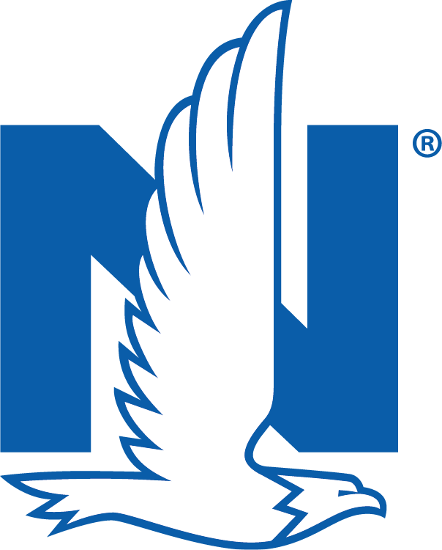


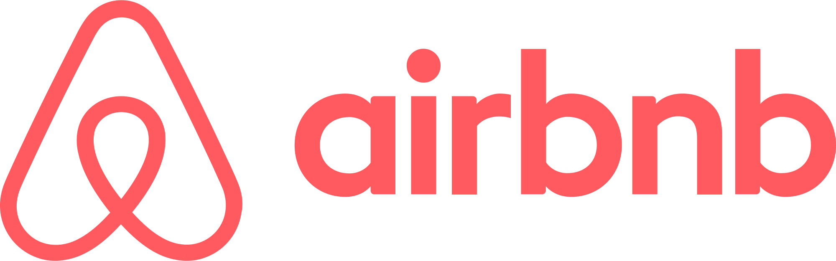


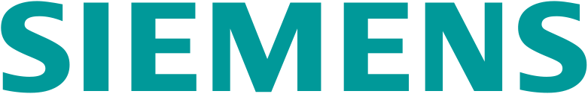




















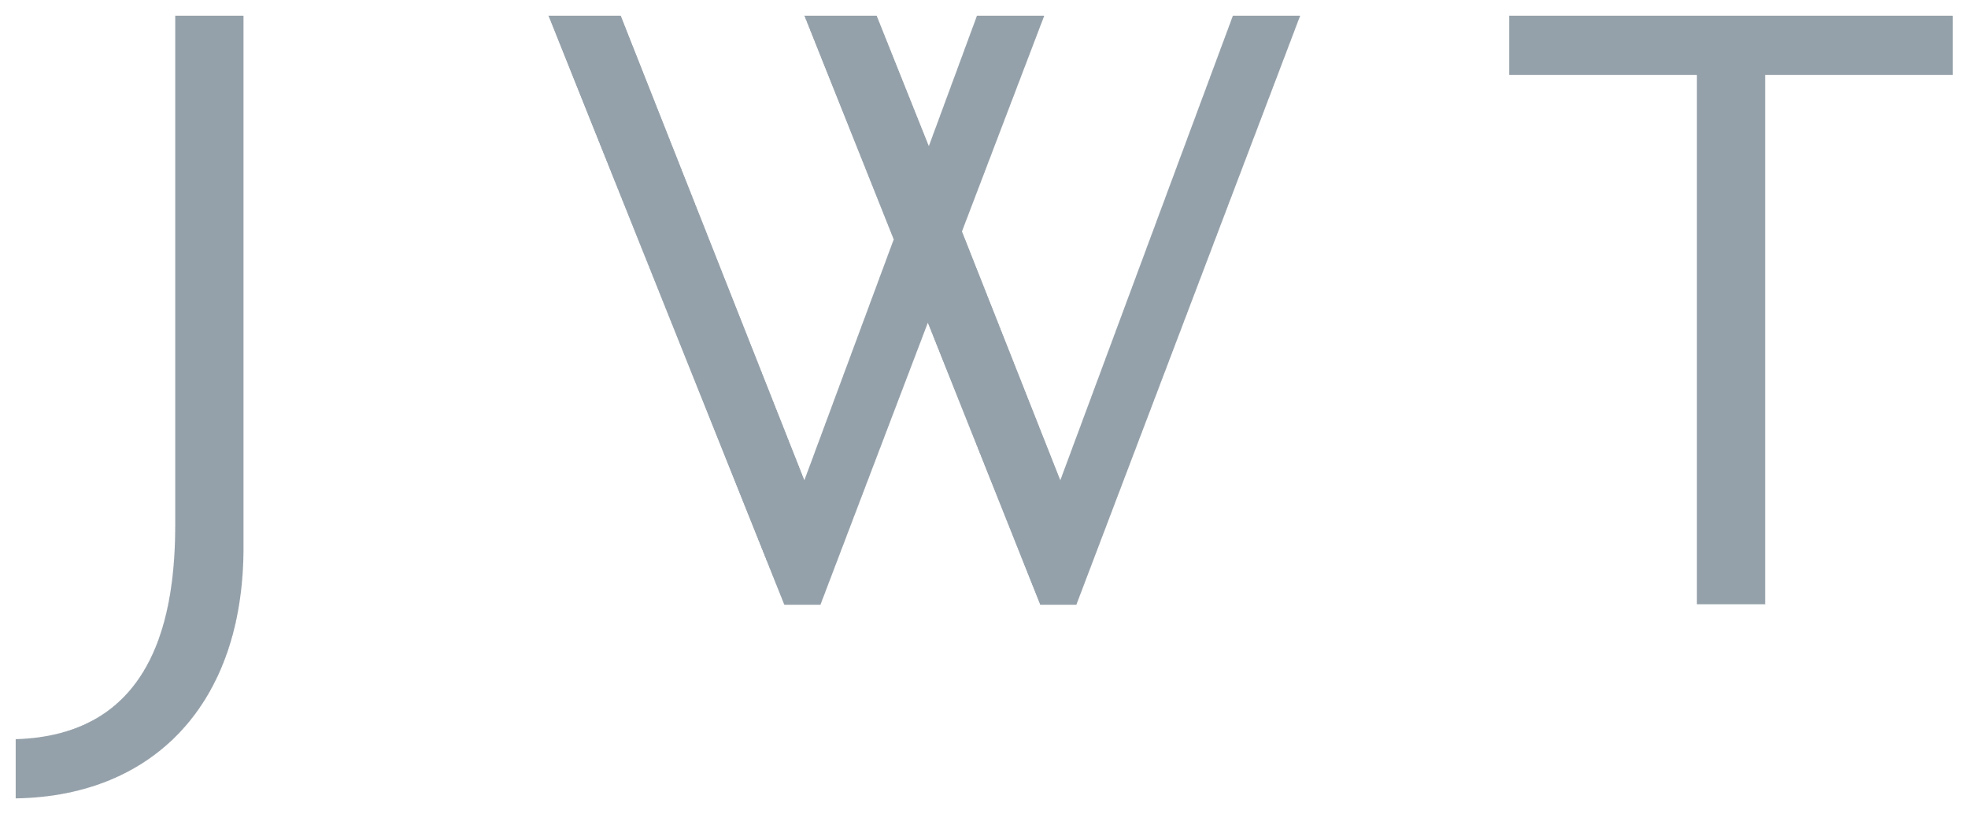








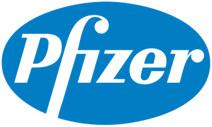


















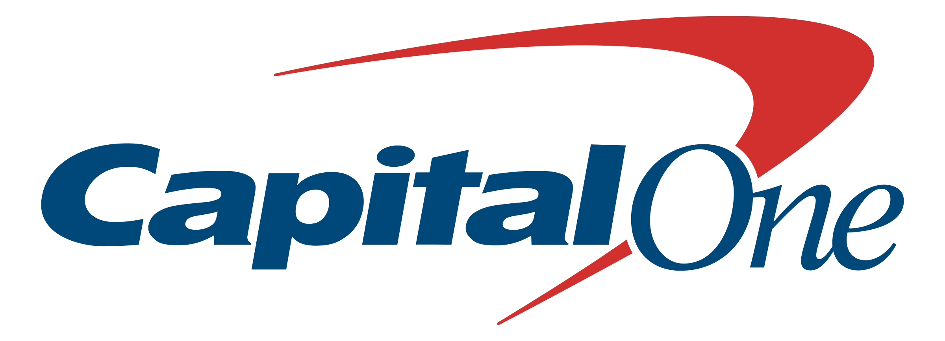

























Industry leaders migrate to AWS

Slide 27

Migration Customer Stories
Notes:
#cloudjourney

Slide 28

The U.S. Navy migrated its largest SAP (ERP) system, 72,000 users spread across six U.S. Navy commands, to AWS GovCloud (US)
50% reduction
in expected
migration time
Reporting time reduced from 5 hours to 0.5 hours
“The magnitude of this accomplishment is incredible. The Navy ERP tech refresh is our largest system cloud migration to date and will enhance the performance of our force.
I am proud of the team efforts to accomplish this on an accelerated schedule, cutting the projected timeline nearly in half.”
—Richard Spencer
Former Navy Secretary, U.S. Navy
Increased
data protection
Highly scalable infrastructure
Notes:
In its mission is to maintain, train, and equip combat-ready naval forces, the U.S. Navy automates many back-office functions related to technology, services, and human resources so that members of the Navy can make informed decisions and focus on their tasks at hand.
However, these on-premises systems have historically been disconnected and dispersed, making it challenging to collect, process, and analyze mission-critical information quickly.
To combat that disconnect, the U.S. Navy and SAP National Security Services (SAP NS2) migrated their largest SAP enterprise resource planning (ERP) system – 72,000 users spread across six U.S. Navy commands – to the Amazon Web Services (AWS) Cloud. The milestone — which came 10 months ahead of schedule — will put the movement and documentation of some $70 billion worth of parts and goods.
Navy ERP data is hosted across both AWS GovCloud (US) Regions. AWS Snowball Edges, a data migration and edge computing device, were used to migrate Navy ERP data to AWS GovCloud (US).
The migration was completed in just under 10 months – nearly half of the time it was originally expected to take given its complexity.
Data processing time cut from 20-hours to 4
The Navy ERP migration to cloud computing is part of a larger three-year, $100-million effort to upgrade Navy computing systems

Slide 29

New Jersey Courts System
“What previously would have taken us months, we can now knock out over a weekend and complete testing and piloting over the next week. Our transition and continued investment in the cloud gives us a much more modern system on which we can build for the future.”
—Jack McCarthy, CIO, New Jersey Courts.
Migrated 40 key applications to AWS
26,000 virtual court events with 217,000 participants facilitated since March’20
99 percent of staff able to work from home
Turnaround time for select tasks reduced from six months to in 6 days
Launched its Judiciary Electronic Document System (JEDS) on AWS in just two days
Notes:
Government is also transforming very during the COVID-19 economy
Even as we focus on Contract Tracing and Infections Disease reporting, Government is embracing cloud to modernize key applications where they can be built far more economically
COVID-19 is forcing whole of society to embrace virtual platforms
The courts system – which processes 7 million cases per year – had already migrated 40 applications to AWS last summer and had been using virtual courtrooms for criminal justice hearings for about three years. But, it was only seeing about 20 to 30 cases a week.
Since the start of the healthcare crisis and associated shelter-in-place orders in March, the courts have facilitated more than 26,000 virtual court events with 217,000 participants.
The New Jersey Courts system was able to stay operational without interruption, even with 99 percent of its staff working from home.
The implications going forward – migrate faster, and design for higher level of remote working

Slide 30



Other migration success stories
Migrated more than 600 workloads to AWS in under 14 months, including some Unix to Linux conversions, driving year-over-year cost reduction, and cut processing time from 36 hours to 10 seconds
Consolidating 56 data centers down to 6, moved 75% of infrastructure to cloud, and re‑allocated more than $100M to key business drivers
Delivered 30 applications into production in 10 weeks of FY18; kicked off a mass migration that in FY19 has now increased to more than 400 apps in the Cloud and helped lower costs by up to 60% per app
Realized a 52% reduction in TCO
Realized a 12x increase in innovation pipeline (Release Velocity)
Notes:
And we have so many stories to share about customers achieving compelling outcomes by migrating and modernizing on AWS, one of which we will be doing a deep dive on today.
News Corp consolidated 56 data centers down to 6 and was able to re-allocate $100M to the business.
Enel migrated more than 5500 VMs in 9 months, reducing storage costs by 50%, compute costs by 20%, an improving provision by 10X.
Coca Cola migrated 600 business workloads in a little over a year.
Conde Nast had a 52% TCO reduction.
------------------------------------------

Slide 31
Actions we recommend
01
Be selective on which apps to transform; focus on differentiators
02
Design and build a service management framework to enable your cloud operating model
03
Choose partner(s) to guide you and bring skills and experience
aws.amazon.com/cloud-migration
Notes:
So to close, and we have covered a lot today, we have 3 guidelines for you to walk away with to successfully Transform, Migration and Govern your application portfolio.
This insight, I remind you, is borne of our looking at over 1,200 migrations, around the world. And from a current 800 engagements we have today.
Be selective on which apps to transform – they take time and people. But pick the right ones and get moving. Plan to migrate and modernize many more, and retire 10%.
Build the tools and processes for a new cloud operating model, use the new Well Architected Management and Governance Lens, and the 20 Vendors we have integrated into 9 AWS services.
Choose a trusted and certified Migration Partner, of whom we have over 100.

Slide 32

Notes:
1 minute
The application migration we’re going to discuss today is part of a comprehensive IT strategy at CSEA. CSEA’s IT strategy is informed and guided by the strategic priorities developed by the State’s IT Steering Committee (ITSC). What you see here is from committee minutes published in 2019 so it may be familiar to you.
As a consultant working in partnership with AWS I selfishly like that the center piece of the Strategic Plan is “Partner for Successful Business Outcomes”.
“Effective partnership between IT and business”
“IT systems are well-engineered and appropriately designed for their intended use”
As we have been working with CSEA in the planning and execution of their migration, I think we have addressed each of these strategic priorities. I’ll refer back to them as we continue CSEA’s story…
Enhance Value of State Data:
“Increased data interoperability & sharing - more opportunity for informed decision making”
“Better service delivery and client experience”
Expand Statewide Cyber Security Strategy
“Increased public trust in systems, state government”
Implement Evergreen IT Operations
“Legacy systems decommissioned”
“Reduced cost of hardware/software development, operations and maintenance”
Alignment to the state’s priorities helps to gain the broad support that improves the chances of success

Slide 33
CSEA Vision
Improve performance measures with decision making tools
Improve customer service
Mission Statement:
“To promote the well-being of children and the self-sufficiency of families through the timely and accurate delivery of Child Support Services, while providing excellence in customer care”
Provide a better experience for customers by moving data to the cloud.
Inform agency users at all levels with insights into customer behavior
Maintain highest levels of IT security
Evergreen IT practices
Protect sensitive customer data and comply with Federal regulations
Implement evergreen IT operations to ensure business systems are ready to always support the current and future needs of business users and citizens
Notes:
2 minutes
The CSEA vision aligns strategic priorities of the ITSC with the mission of CSEA
Customer Service:
Easier it is for customers the more timely they will be in making support payments
Improve decision making capabilities. Performance –
Decision making:
Are payments on time? Who is delinquent? Any patterns? Who needs to respond
Security:
Must protect customers’ personal financial information
IRS 1075 compliance.
#4 Pursue state’s evergreen technology initiative – don’t build on-prem – ETS strategic plan

Slide 34







CSEA Legacy Environment
KEIKI mainframe
Interactive Voice Response (IVR) API
Replication
[P-logs nightly batch]
CSEA on-premise
CSEA Staging Database
csea.ehawaii.gov website
Files
SAP Business Objects
Notes:
30 seconds
Copies needed for Federal fiscal year-end reporting
IVR currently running on a CSEA AWS account. As part of
Website
extracts

Slide 35








Challenges of Modernization
Legacy Database
Analytics
Friction for customers and agency users to interact with data on the KEIKI mainframe
Challenge for agency to operate decision support system
Customers
KEIKI mainframe
Agency Users
Notes:
30 seconds
Analytics:
Agency users including administrators want more self-service reporting capabilities
Need to embed analytics and reporting into operational workflow
KEIKI mainframe
SQL Servers on-prem
Business objects on-prem

Slide 36
Application Migration Strategy: Proof of Acceleration
Infrastructure
Customer & Agency Portals
Security
Scalability
Durability
Security
Workflows
Awesome user experience
Data Replication
Analytics
Feasibility
Affordability
Performance
Performance
Self-sufficiency
Affordability
Notes:
2 minutes
AWS infrastructure PoC:
Security - Federal Tax Information (FTI) and Federal Parent Locator Service (FPLS) data
Reliability
CSEA network
Performant
Build a properly architected, ie “well architected framework”
Data Replication:
Feasible – is it even possible?
Cost – does it make sense?
Reliable?
Performance?
“As table structure is added and modified to Database B, the POC database(s) shall reflect these changes accordingly. ”
Portal Architecture
Data security
Interact with KEIKI data to pre-populate a form and route through most complicated workflow
Analytics
Need to replace the Decision Support System (DSS) running on SAP Business Objects which is facing an end of life at the end of 2022
Rebuild the most complicated report
Can we query KEIKI data
Replace Business objects?
Can CSEA maintain and operate it themselves
Provide self-service business intelligence to end users
Can analytics be built into operational workflows
CSEA had a software definition document which highlighted what we call “non-functional” requirements.
“Data encrypted at rest”
“data encrypted in transit”
And Success criteria
“Pleasant and successful”, “Simple and easy to use”, Includes self-service capability to the fullest extent possible”
Satisfies the 5 pillars of the well-architected framework
We designed these proof of concepts to address

Slide 37










Iterative Planning
Notes:
15 seconds
Our Clyde Shiigi and Becky Arakawa worked with Norman Yoshikami

Slide 38
High Level Planning
Move to AWS
Transform on AWS
Lift & shift
Modernize
Serverless / containers / microservices
30%
70%
Re-platform
Notes:
After all the iterative planning we roughly estimate that 30% of the work effort and cost would be in Lift & Shift and Re-platforming with the other 70% in the work to modernize
And the idea is to not only modernize their infrastructure, platforms and applications, but to modernize the skill set of their staff. A transformation of the IT organization.

Slide 39




















AWS GovCloud
DevOps
AWS CodeCommit
AWS CodeBuild
AWS CodeDeploy
AWS Secrets Manager
Amazon CloudWatch
Amazon Athena
Compute & Integration
Amazon API Gateway
AWS Lambda
Amazon Simple Notification Service (Amazon SNS)
Amazon Simple Email
Service (Amazon SES)
Web
Amazon Cognito
Amazon Route 53
AWS WAF
Amazon CloudFront
Data & Analytics
Amazon Simple Storage Service (Amazon S3)
Amazon Relational Database Service (Amazon RDS)
Amazon DynamoDB
AWS Database Migration Service (AWS DMS)
Amazon QuickSight
Notes:
3-5 minutes
The architecture being developed includes services to support the proof of acceleration projects for Data Replication, Customer and Agency Portal and Analytics.
1) The foundation of the stack is the Data layer which includes:
A couple instances of PostgreSQL RDS. One is the destination for replicated data from KEIKI and another to run the customer and agency portals.
S3 buckets to receive and process files for Analytics. Also static files for the portals.
Dynamo DB which is a key-value pair NoSQL data store which we use the Time to Live feature to support workflow logic of forms in the portals
Finally Database Migration Service or DMS which I will get into shortly
2) Next are the services that support the portals which are Web applications. It includes Cognito as the identity solution which supported federated identity pools so we are planning to leverage ETS’ Azure AD for authentication of state users.
3) The compute and integration workloads are handled by APIs on Lambda. Where API calls are not going through API gateway we use SNS as a message queuing service. SES is used for email notifications to customers. Lambdas are the key to building a microservice architecture.
We are NOT building a monolithic architecture
4) Finally to develop and operate everything is the DevOps layer….
Important to note that the architecture is constantly evolving as
new services become available
costs are optimized
and most importantly, new business needs arise. As stated in the Strategic Priorities, “faster response to changing business needs”.
No VMs, No EC2s (except for a jumpbox used for secured access to the postgresql RDS)

Slide 40





KEIKI Data Replication
VPC
Private subnet
KEIKI mainframe
Replication
[P-logs nightly batch]
PostgreSQL Database (Amazon RDS)
CSEA on-premise
AWS Site-to-Site VPN
CSEA Staging
MS SQL Server 2019
Customer gateway
AWS Transit Gateway
AWS Database Migration Service (AWS DMS)
Notes:
The source database remains fully operational during the migration, which in our case is on-going replication.
AWS Database Migration Service supports homogeneous migrations such as Oracle to Oracle, as well as heterogeneous migrations between different database platforms, such as Oracle or Microsoft SQL Server to Amazon Aurora
In the first iteration we did a homogeneous replication from CSEA’s on-prem SQL Server 2019 to a SQL Server RDS. We are now in the second iteration and we have completed a heterogeneous on-going replication from CSEA’s on-prem SQL Server to a PostgreSQL RDS.
Only issue we’ve encountered is that data validation is taking a long time. (? For Andrew: was that validation for the first replication or is the validation for the on-going replication also taking a long time?)
Cost savings is …..
Connectivity options: transit gateway, VPN, . AWS recommends DirectConnect. We used transit gateway because it is encrypted, whereas DirectConnect

Slide 41


DMS Instances
c
c
Notes:
DMS is a replication instance (basically an EC2, backend is SQLlite) as an EC2 can choose family type, size, ie. cost.
Can use multiple instances OR one instance can run multiple migrations
1) Replication instance – sized appropriately. Want to minimize idle time.
Connection Types: SQL Server, PostgreSQL, etc

Slide 42

DMS Endpoints
c
c
Notes:
2) Create source connections – can have multiple source connections. Not all latest versions supported until drivers supported.
3) Create target connections – can have multiple target connections.

Slide 43

DMS Tasks
c
c
Notes:
4) Setup Tasks
not all tasks can be validated
We kick off tasks manually but can be scheduled
When setting up task, choose instance. 1 source and 1 target connection
task for initial pull, task for initial validation, task for on-going replication, task for on-going validation
Tasks can be specific to tables
4a) Action – 3 types
1-migration
2-ongoing replication
3-migration then immediately go to on-going replication
4 task options: start, stop, resume, restart
Performance dependent on source network, and source server and connectivity
Need to monitor network bandwidth and server performance. We pegged the CPU on the server.

Slide 44


CSEA Portal
Application Migration Strategy: Proof of Acceleration
Customer & Agency Portals
Security
Workflows
Awesome user experience

Slide 45



Notes:
4 decision points
Pre-populate forms with data from KEIKI
Save drafts
Predefined wait times
Email notifications
Back and forth between Custodial and Non-custodial parents
Generate PDFs for printable. And the template of the form has to be manageable by the agency so that they can change values such as the name of the Attorney General
Review and approvals by the CSEA

Slide 46










Portal Architecture
S3 Buckets
Customers
Agency Users
VPC
VPC
Private subnet
Private subnet
React
ETS Azure AD
Amazon Route 53
PostgreSQL RDS (Replicated KEIKI data)
PostgreSQL RDS (Application Database
CSEA on-premise
API Gateways
Amazon Cognito
AWS WAF
Amazon CloudFront
Lambda functions
KEIKI Data
AWS Database Migration Service (AWS DMS)
Amazon DynamoDB
Amazon CloudWatch
Amazon Simple Email
Service (Amazon SES)
Notes:
Microservices vs. Monolithic architecture
Loosely coupled
LumiSight framework
How do RDS’ connect?

Slide 47


CSEA Analytics
Application Migration Strategy: Proof of Acceleration
Analytics
Performance
Self-sufficiency
Affordability
Notes:
Connor demo

Slide 48



Slide 49



Slide 50
Analytics Architecture
VPC
Private subnet
MS SQL RDS (Replicated KEIKI data)
Amazon QuickSight
Data Sets
CSEA on-premise
CSEA on-premise
KEIKI Data
AWS Database Migration Service (AWS DMS)
Files
Amazon Simple Storage Service (Amazon S3)

Slide 52

Feedback Please!
URL : https://eventbox.dev/survey/XM58Y3B
Stason Rodrigues | Solutions Architect | AWS | stasonr@amazon.com
Rishabh Doshi | Manager, Solutions Architecture | AWS | rishdosh@amazon.com
Jeff Masumoto | VP Solutions & Consulting Services | DataHouse | jeff_masumoto@datahouse.com

